Slide 1

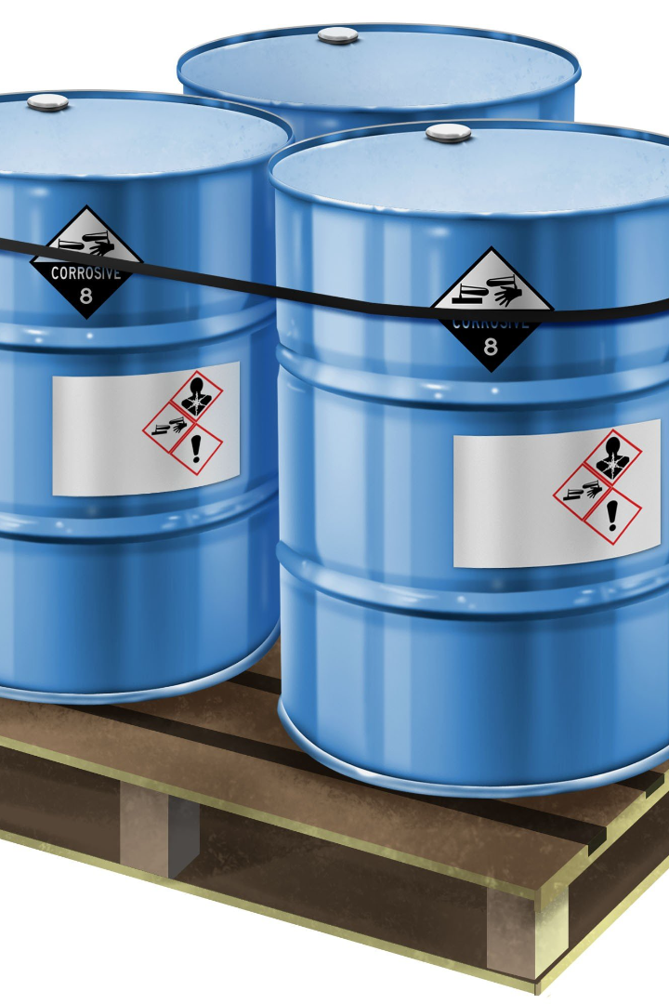
Chemical Safety Hazards and Precautions
Types of Chemical Interview Questions and Answers

Slide 2
Chemical Safety
Chemical safety refers to the practices and protocols put in place to prevent accidents, injuries, or exposure to hazardous substances in various settings like laboratories, industries, and households.

Slide 3
Chemical Hazards:
1. Toxicity:
Description: Chemicals that are toxic can cause harm or adverse effects when inhaled, ingested, or come into contact with the skin or eyes.
Example:
Arsenic: Found in pesticides, can cause poisoning and long-term health issues.
Lead: Found in old paint, can lead to neurological damage.

Slide 4
2. Flammability:
Description: Substances that can easily catch fire or ignite, leading to fires or explosions.
Example:
Gasoline: Highly flammable, used as a fuel but can cause fires if mishandled.
Acetone: Commonly used as a solvent, highly flammable in its liquid state.

Slide 5
3. Corrosivity:
Description: Chemicals that can cause damage or destruction to materials or living tissue upon contact.
Example:
Sulfuric Acid: Used in manufacturing, can cause severe burns on contact with skin.
Hydrochloric Acid: Found in cleaning products, can corrode metals and cause skin irritation.

Slide 6
4. Reactivity:
Description: Chemicals that can react violently with other substances, leading to explosions or the release of toxic gases.
Example:
Chlorine Gas: Used in various industries, can be toxic and reactive, causing respiratory problems.
Potassium Permanganate and Glycerin Reaction: Can cause spontaneous ignition.

Slide 7
5. Biohazards:
Description: Chemicals that can pose a threat to living organisms or the environment.
Example:
Pesticides: Used in agriculture, can harm non-target organisms and contaminate the ecosystem.
Chemicals used in Pharmaceutical Research: May have adverse effects on laboratory animals or the environment if improperly handled or disposed of.

Slide 8
6. Asphyxiant Hazards:
Description: Chemicals that displace oxygen in the air, leading to suffocation.
Example:
Carbon Dioxide (CO2): In high concentrations, can cause asphyxiation by reducing available oxygen.

Slide 9
Precautions to Ensure Safety:
Conducting risk assessments before handling chemicals.
Using appropriate personal protective equipment (PPE) like gloves, goggles, and lab coats.
Proper ventilation in work areas.
Labeling chemical containers clearly.
Training employees on safe handling and emergency procedures.
Regular maintenance and inspection of equipment.

Slide 10
Types of Chemicals:
1. Organic Chemicals:
Description: Derived from living organisms, these compounds contain carbon and typically have covalent bonds.
Example: Ethanol (C2H5OH) - Found in alcoholic beverages, used as a solvent and in fuel.

Slide 11
2. Inorganic Chemicals:
Description: These compounds lack carbon and are often minerals or salts.
Example: Sodium Chloride (NaCl) - Common table salt used in cooking and various industrial processes.

Slide 12
3. Toxic Chemicals:
Description: Substances that can cause harm to living organisms upon exposure, even in small amounts.
Example: Mercury (Hg) - Found in some thermometers and industrial processes, harmful if ingested or inhaled.

Slide 13
4. Flammable Chemicals:
Description: Substances that can ignite and burn easily in the presence of a flame or spark.
Example: Propane (C3H8) - Used as a fuel for heating and cooking.

Slide 14
5. Corrosive Chemicals:
Description: Substances that can cause damage or destruction to materials or living tissue upon contact.
Example: Sulfuric Acid (H2SO4) - Used in batteries, manufacturing, and cleaning agents.

Slide 15
Interview Questions and Answers:
What are the primary hazards associated with chemical exposure?
Answer: Chemical exposure can lead to various hazards such as toxicity, flammability, corrosiveness, and environmental harm.

Slide 16
How do you ensure chemical safety in a laboratory setting?
Answer: By implementing strict protocols, including risk assessments, proper labeling, adequate ventilation, and mandatory use of personal protective equipment.

Slide 17
What steps would you take in case of a chemical spill in the workplace?
Answer: Immediately contain the spill, evacuate the area if necessary, and follow established procedures for cleanup while wearing appropriate protective gear.

Slide 18
Describe the importance of MSDS (Material Safety Data Sheets) in chemical safety.
Answer: MSDS provides crucial information about chemical properties, hazards, handling, storage, and emergency procedures, ensuring safe usage and handling of chemicals.

Slide 19
How do you differentiate between a flammable and a corrosive chemical?
Answer: Flammable chemicals can easily catch fire or ignite, while corrosive chemicals can cause damage upon contact, often eating away at surfaces or causing burns on skin.

Slide 20


