Slide 1
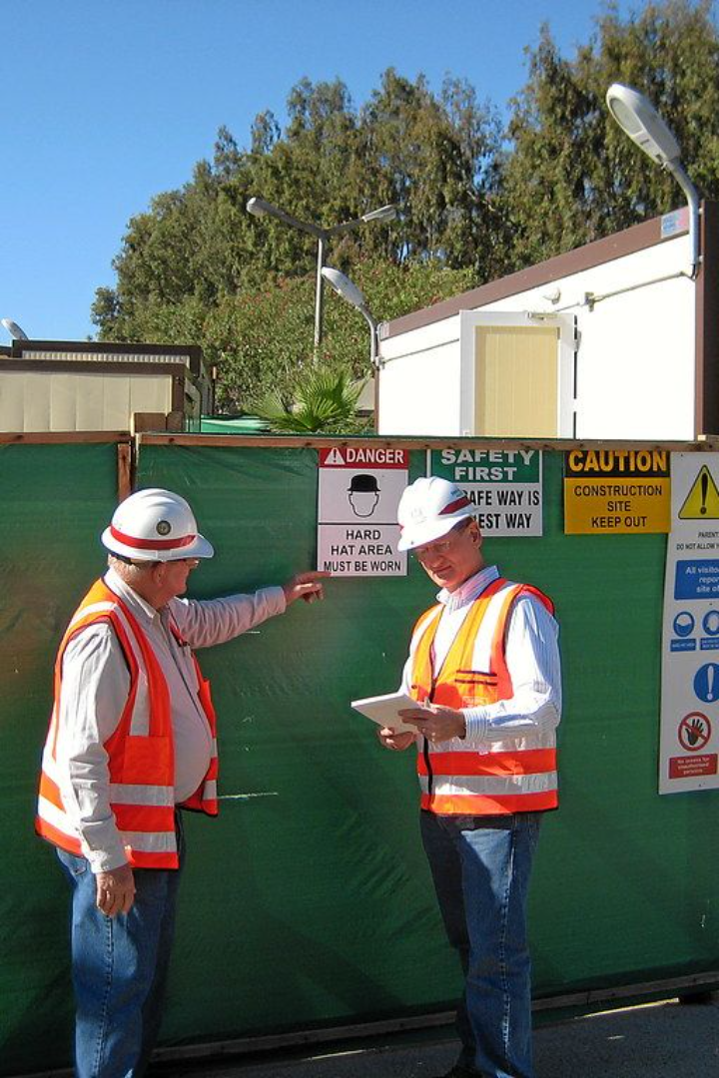
Construction Safety MCQs

Slide 2

Question: What is the primary purpose of a Safety Data Sheet (SDS) on a construction site?
A) To list the contact information of project managers
B) To provide information on hazardous chemicals used on-site
C) To outline the construction timeline
D) To describe the architectural plans

Slide 3

Answer: B) To provide information on hazardous chemicals used on-site
Explanation: The Safety Data Sheet (SDS) is crucial for providing comprehensive information about hazardous chemicals used on-site. It includes details about potential hazards, safe handling procedures, and emergency measures.

Slide 4
Question: What is the minimum recommended height for fall protection equipment to be used on construction sites?
A) 4 feet (1.2 meters)
B) 6 feet (1.8 meters)
C) 8 feet (2.4 meters)
D) 10 feet (3 meters)

Slide 5
Answer: B) 6 feet (1.8 meters)
Explanation: Fall protection equipment is required for heights of 6 feet (1.8 meters) or more. This is a standard safety practice to prevent injuries due to falls from elevated areas.

Slide 6
Question: What is the purpose of a "buddy system" in construction safety?
A) To minimize overtime work
B) To ensure workers have friends on-site
C) To pair workers to watch out for each other's safety
D) To promote healthy competition among workers

Slide 7
Answer: C) To pair workers to watch out for each other's safety
Explanation: Implementing a "buddy system" ensures that workers watch out for each other's safety. It fosters a culture of mutual responsibility and aids in immediate assistance in case of emergencies or accidents.

Slide 8
Question: Which of the following is a common hazard associated with trenching and excavation work?
A) Overhead lighting
B) Heat exhaustion
C) Cave-ins
D) Loud noises

Slide 9
Answer: C) Cave-ins
Explanation: Cave-ins are a significant risk associated with trenching and excavation work. Protective measures such as trench boxes or shoring must be implemented to prevent collapse-related accidents.

Slide 10
Question: What should workers do if they encounter damaged or defective personal protective equipment (PPE)?
A) Continue using it until the end of the shift
B) Report it immediately and replace it
C) Ignore it if it doesn't impact safety directly
D) Modify it to make it usable

Slide 11
Answer: B) Report it immediately and replace it
Explanation: Any damaged or defective Personal Protective Equipment (PPE) should be reported immediately and replaced to ensure worker safety. Continued use of compromised PPE can increase the risk of injuries.

Slide 12
Question: Which type of scaffolding provides the most maneuverability on a construction site?
A) Single pole scaffold
B) Suspended scaffold
C) Mobile scaffold
D) Cantilever scaffold

Slide 13
Answer: C) Mobile scaffold
Explanation: Mobile scaffolding offers easy mobility and flexibility on construction sites, allowing workers to move it to various locations as needed.

Slide 14
Question: What is the purpose of a "confined space entry permit" in construction safety?
A) To allow unrestricted access to confined spaces
B) To document hazards and safety measures for entering confined spaces
C) To limit the number of workers in confined spaces
D) To ignore safety protocols in confined spaces

Slide 15
Answer: B) To document hazards and safety measures for entering confined spaces
Explanation: The permit documents hazards and safety measures required for entry into confined spaces, ensuring proper safety protocols are followed before accessing such areas.

Slide 16
Question: Which type of hazard does "struck-by" refer to in construction safety?
A) Falls
B) Being hit by moving objects
C) Electrical shocks
D) Exposure to hazardous chemicals

Slide 17
Answer: B) Being hit by moving objects
Explanation: "Struck-by" refers to the risk of being hit by moving objects on a construction site, highlighting the importance of wearing appropriate protective gear and being aware of surroundings.

Slide 18
Question: What is the purpose of conducting regular safety toolbox talks on a construction site?
A) To discuss the latest sports news
B) To educate workers about safety procedures and hazards
C) To promote sales of construction equipment
D) To plan social events for workers

Slide 19
Answer: B) To educate workers about safety procedures and hazards
Explanation: Toolbox talks are conducted to educate workers about safety procedures, potential hazards, and best practices on-site, fostering a safety-oriented work environment.

Slide 20
Question: What is the primary purpose of conducting regular safety inspections on a construction site?
A) To impose fines on workers for safety violations
B) To identify and rectify potential hazards
C) To reduce productivity among workers
D) To increase insurance premiums

Slide 21
Answer: B) To identify and rectify potential hazards
Explanation: Safety inspections aim to identify and rectify potential hazards, ensuring a safer working environment for all workers on-site.

