Slide 1

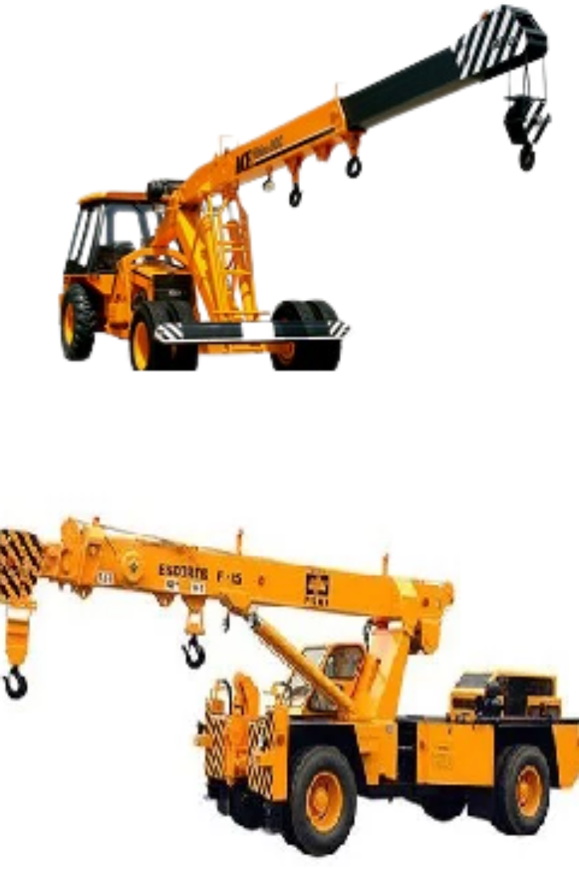
Difference Between Hydra Crane Farana Crane?

Slide 2
Hydra Crane and Farana Crane
Hydra crane and Farana crane are two distinct types of cranes used for lifting and moving heavy loads, but they have several differences:

Slide 3
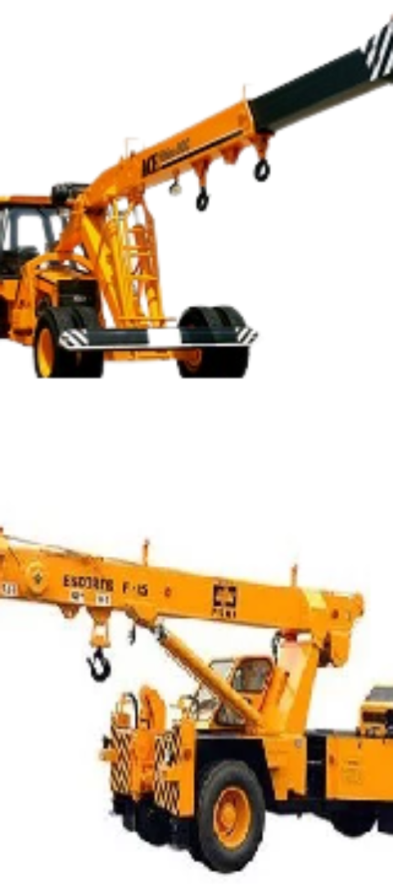
Operating Mechanism:
Hydra Crane:
Farana Crane:
A hydra crane operates on hydraulic mechanisms, utilizing oil pressure to generate force for lifting heavy objects. These cranes typically have a telescopic boom that can extend and retract.
Farana crane, also known as a mobile crane, operates on a different mechanism. It relies on a lattice boom or telescopic boom attached to a mobile platform. The Farana crane's operation may involve hydraulic or mechanical systems.

Slide 4
Design and Functionality:
Hydra Crane:
Farana Crane:
Hydra cranes are versatile and can be used for various applications due to their ability to extend and lift heavy loads using hydraulic power.
Farana cranes, being mobile cranes, are designed for mobility and versatility in different job sites. They might have a higher reach and lifting capacity compared to hydra cranes in some cases.

Slide 5

Lifting Capacity:
Hydra Crane:
Farana Crane:
Generally, hydra cranes have a lower lifting capacity compared to larger mobile cranes like Farana cranes.
Farana cranes are built to handle heavier loads and often come with a higher lifting capacity than hydra cranes. They are commonly used in construction sites for heavy lifting tasks.

Slide 6
Applications:
Hydra Crane:
Farana Crane:
Hydra cranes are often used for lighter lifting tasks in industries like maintenance, repair work, and smaller construction projects.
Farana cranes are used in larger construction projects, industrial settings, and infrastructure development where heavier loads need to be lifted and transported over greater distances.

Slide 7
Mobility:
Hydra Crane:
Farana Crane:
Hydra cranes might have limited mobility compared to Farana cranes due to their design and lifting capacity.
Farana cranes are built on a mobile platform, allowing them to be transported easily from one job site to another. They have better mobility and can navigate through construction sites more effectively.

Slide 9
Conclusion
In summary, hydra cranes are more versatile for lighter lifting tasks, whereas Farana cranes are designed for heavier lifting and are more mobile, making them suitable for larger construction projects and industrial applications.

