Slide 1

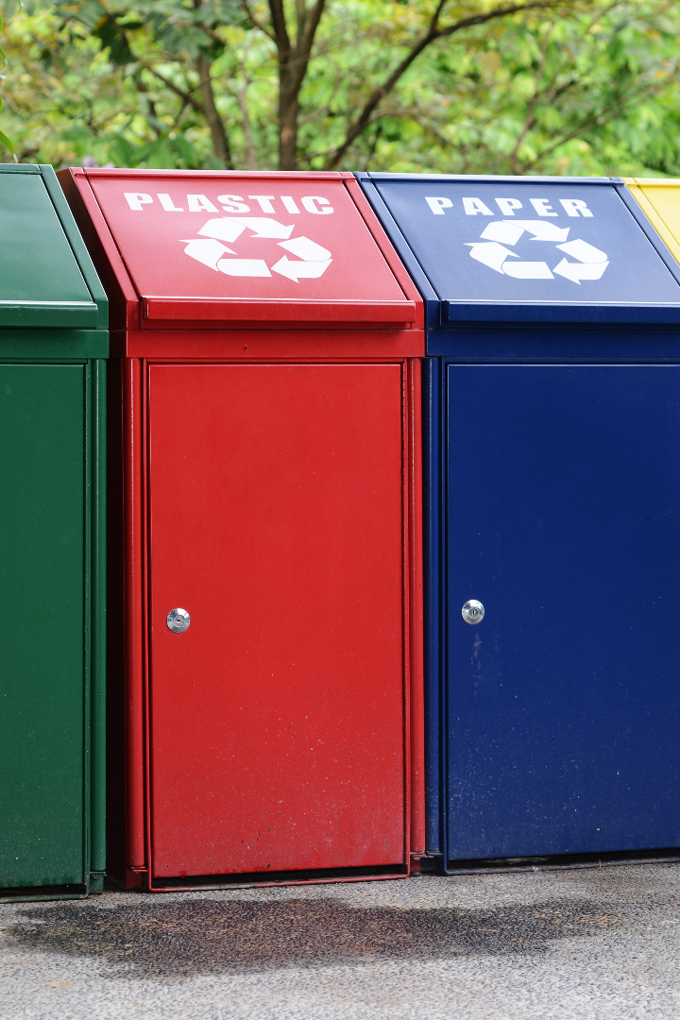
Hazardous Waste Management System

Slide 2
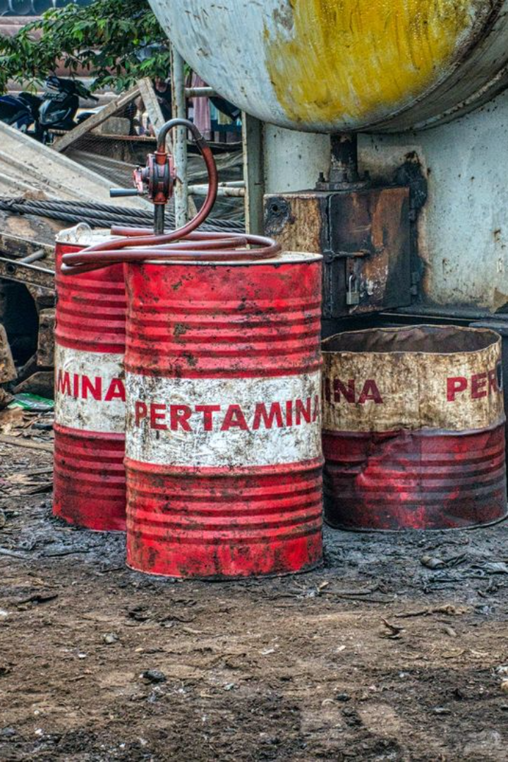
Hazardous Waste Management System
A hazardous waste management system involves the handling, storage, treatment, and disposal of materials that pose significant risks to human health and the environment. It's crucial to have a well-structured system in place to properly identify, categorize, and manage these hazardous materials. This typically includes steps like:

Slide 3
Hazardous Waste Management System
Identification and Classification: Determining what materials qualify as hazardous waste according to regulatory guidelines. This involves understanding their properties and potential risks.
Segregation and Storage: Properly separating hazardous materials from non-hazardous ones to prevent contamination. Storing them in secure, labeled containers or designated areas to minimize potential risks.
Transportation: Following specific regulations for the safe transportation of hazardous waste, including using specialized containers and vehicles to prevent spills or leaks.
Treatment and Processing: Employing various methods like chemical, physical, or biological processes to neutralize or reduce the hazardous nature of the waste before disposal.

Slide 4
Hazardous Waste Management System
Disposal: Ensuring the safe and environmentally responsible disposal of hazardous waste, which may involve incineration, secure landfilling, or other approved methods to minimize harm to the environment and public health.
Documentation and Compliance: Keeping detailed records of the entire waste management process to comply with regulations and standards set by local, national, and international authorities.

Slide 5
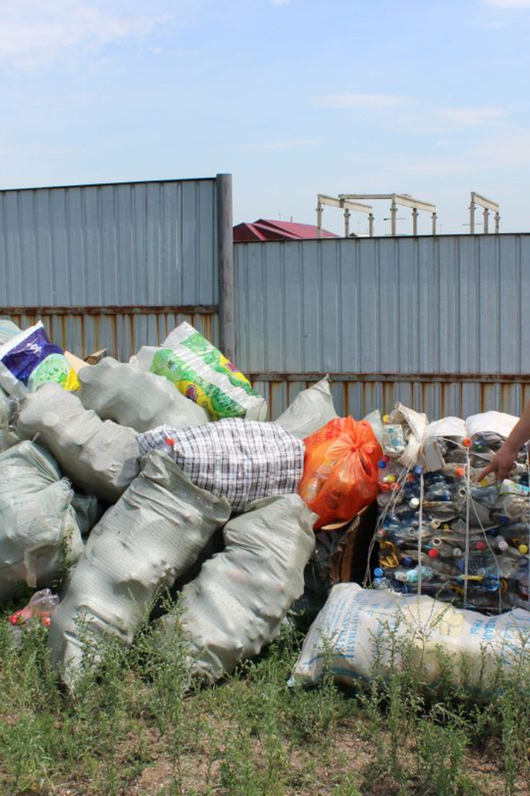
Here's an example illustrating the steps involved in a hazardous waste management system:
XYZ Industrial Facility Hazardous Waste Management System

Slide 6
XYZ Industrial Facility Hazardous Waste Management System
Identification and Classification: XYZ Industrial Facility conducts regular assessments of all materials used in its manufacturing processes. Chemicals such as solvents, acids, and heavy metals are identified as hazardous waste based on their properties and potential risks to health and the environment.
Segregation and Storage: Hazardous waste is segregated from non-hazardous materials upon production. It's stored in clearly labeled, leak-proof containers in designated areas equipped with secondary containment measures to prevent any spills or leaks.
Transportation: Trained personnel handle the transportation of hazardous waste using specialized containers and vehicles compliant with transportation regulations. They follow established protocols to ensure the safe transfer of materials to treatment or disposal facilities.
Treatment and Processing: XYZ Facility has a waste treatment plant on-site equipped with technologies for neutralizing hazardous characteristics in waste. Processes like chemical treatment or biological degradation are employed to reduce the toxicity of the materials before disposal.

Slide 7
XYZ Industrial Facility Hazardous Waste Management System
Disposal: After treatment, the waste is disposed of through approved channels. Hazardous waste that cannot be treated on-site is transported to licensed off-site facilities for secure disposal, such as high-temperature incineration or secure landfilling.
Documentation and Compliance: Throughout the entire process, detailed records are maintained. These records include waste generation quantities, treatment methods used, transportation manifests, and disposal certificates. Regular audits ensure compliance with local, state, and federal regulations.

Slide 8

Effective hazardous waste management is critical to prevent environmental pollution, safeguard public health, and maintain regulatory compliance. Companies and organizations handling hazardous waste must prioritize safety, sustainability, and adherence to legal requirements throughout the waste management lifecycle.

