Slide 1

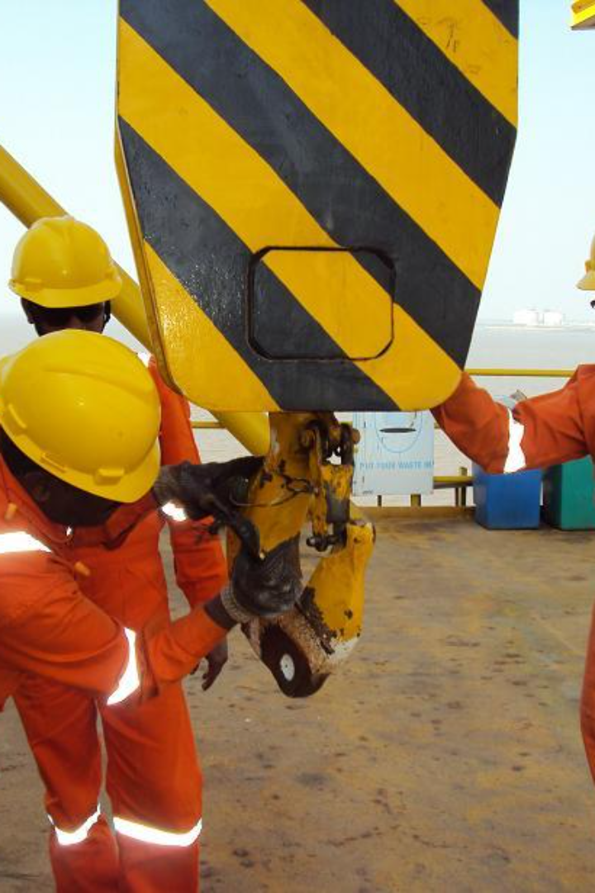
Lifting Tools and Tackles
Rejection Criteria

Slide 2
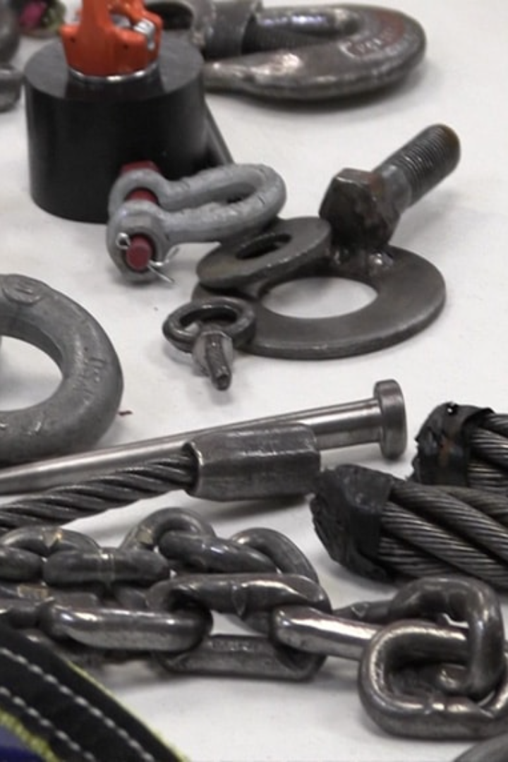
Lifting Tools and Tackles
Rejection criteria for lifting tools and tackles typically involve various factors to ensure safety and compliance. Here are some common rejection criteria:

Slide 3

Rejection Criteria for lifting tools and tackles
Visible Damage:
Manufacturer Specifications:
Any visible signs of cracks, deformation, wear beyond acceptable limits, or corrosion can lead to rejection. This includes damage to hooks, shackles, chains, slings, or any other components.
If the lifting equipment does not meet manufacturer specifications or has been modified without proper authorization, it should be rejected.

Slide 4
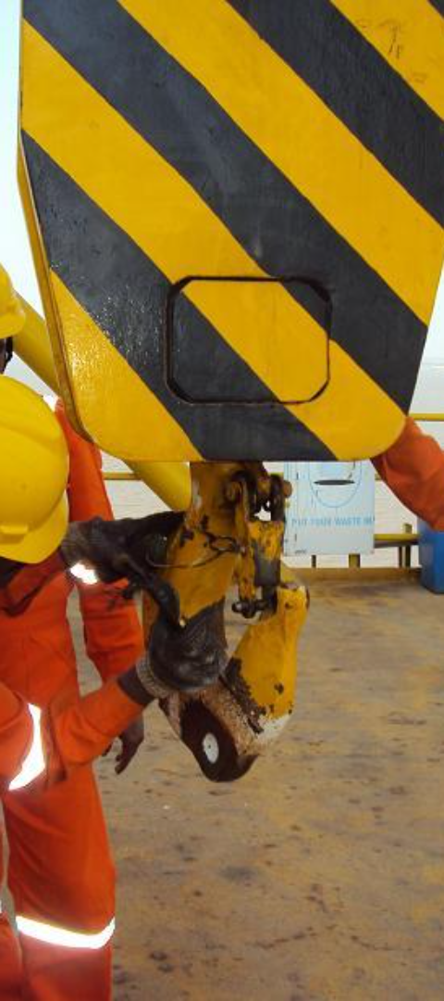
Rejection Criteria for lifting tools and tackles
Missing or Illegible Markings:
Inadequate Documentation:
Lifting equipment should have clear and legible markings indicating its safe working load (SWL), serial number, and other relevant information. Missing or illegible markings could lead to rejection.
Absence or inadequacy of necessary documentation, such as inspection records, certifications, or compliance reports, can result in rejection.

Slide 5

Rejection Criteria for lifting tools and tackles
Overloading or Misuse:
Worn-out or Frayed Components:
Signs of overloading beyond the rated capacity or evidence of misuse can lead to immediate rejection.
Slings, ropes, or cables showing signs of excessive wear, fraying, or broken strands should be rejected as they might compromise the safety of the lifting operation.

Slide 6
Rejection Criteria for lifting tools and tackles
Inoperable Safety Features:
Outdated Inspections:
Any lifting equipment missing or with inoperable safety features, like latch mechanisms on hooks or locking systems, should be rejected.
If the equipment hasn’t undergone scheduled inspections or the last inspection date has expired, it should be rejected until a proper inspection is carried out.

Slide 7
Rejection Criteria for lifting tools and tackles
Unsafe Environmental Exposure:
Inadequate Load Testing:
Equipment exposed to extreme environmental conditions that might compromise its integrity, such as exposure to chemicals or high temperatures, could be rejected.
If the equipment hasn’t undergone necessary load testing procedures or hasn’t been tested according to industry standards, it should be rejected.

Slide 8
Conclusion
These rejection criteria are essential to ensure the safety and reliability of lifting tools and tackles in various industrial and operational settings. Regular inspections, adherence to manufacturer guidelines, and compliance with safety standards are crucial to minimize the risk of accidents.

