Slide 1

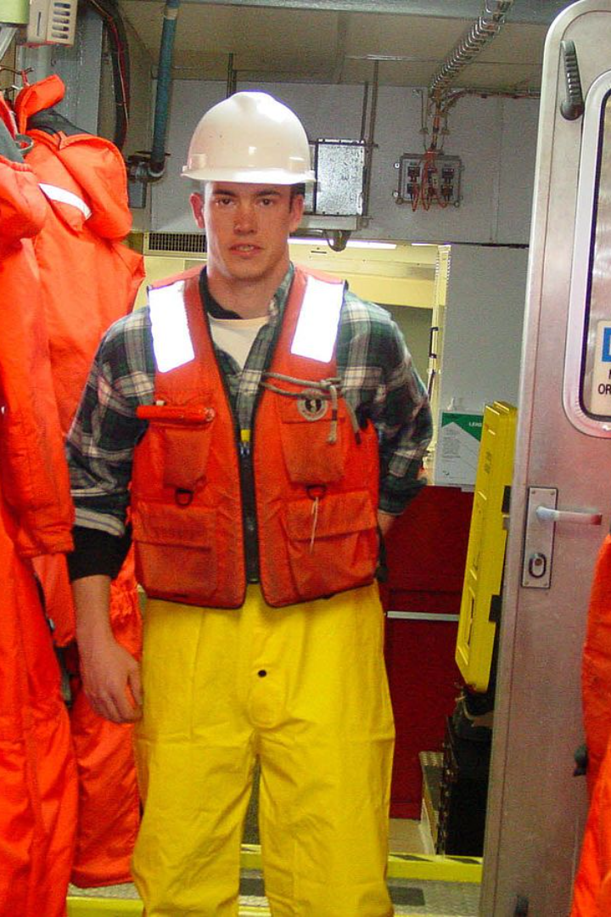
40 Duties Of
A Safety Officer
You Must Know

Slide 2
40 Duties Of A Safety Officer You Must Know
Risk Assessment: Identify and assess potential risks in the workplace.
Safety Inspections: Conduct regular inspections to ensure compliance with safety regulations.
Emergency Preparedness: Develop and implement emergency response plans.
Training Programs: Organize safety training programs for employees.

Slide 3
40 Duties Of A Safety Officer You Must Know
Incident Investigation: Investigate accidents and incidents to determine causes and prevent recurrence.
Safety Policies: Develop and enforce safety policies and procedures.
Hazard Communication: Ensure effective communication of workplace hazards to employees.
Personal Protective Equipment (PPE): Ensure proper use and maintenance of PPE.

Slide 4
40 Duties Of A Safety Officer You Must Know
First Aid: Coordinate first aid and medical assistance programs.
Safety Meetings: Conduct regular safety meetings with employees.
Compliance Monitoring: Monitor and enforce compliance with safety regulations.
Safety Data Sheets (SDS): Maintain and update SDS for hazardous substances.

Slide 5
40 Duties Of A Safety Officer You Must Know
Fire Safety: Implement and oversee fire safety measures.
Machine Guarding: Ensure proper guarding of machinery to prevent accidents.
Workplace Ergonomics: Assess and improve ergonomic conditions in the workplace.
Fall Protection: Implement measures to prevent falls from heights.

Slide 6
40 Duties Of A Safety Officer You Must Know
Electrical Safety: Enforce electrical safety practices and standards.
Chemical Safety: Manage and control the use of hazardous chemicals.
Confined Space Entry: Oversee safety procedures for confined space entry.
Noise Control: Implement measures to control workplace noise levels.

Slide 7
40 Duties Of A Safety Officer You Must Know
Ventilation: Ensure proper ventilation in work areas.
Safety Audits: Conduct regular safety audits and inspections.
Safe Lifting Practices: Promote safe lifting techniques to prevent injuries.
Safety Signage: Install and maintain appropriate safety signs.

Slide 8
40 Duties Of A Safety Officer You Must Know
Record Keeping: Maintain accurate safety records and documentation.
Safety Reporting: Facilitate the reporting of safety concerns by employees.
Job Safety Analysis (JSA): Conduct JSAs for high-risk tasks.
Safety Culture: Promote a positive safety culture within the organization.

Slide 9
40 Duties Of A Safety Officer You Must Know
Safety Committee: Participate in or lead safety committees.
Radiation Safety: Implement measures for the safe use of radiation sources.
Environmental Compliance: Ensure compliance with environmental regulations.
Safety Equipment Inspection: Regularly inspect and maintain safety equipment.

Slide 10
40 Duties Of A Safety Officer You Must Know
Contractor Safety: Oversee safety practices of contractors on-site.
Traffic Safety: Implement measures for traffic safety in workplace areas.
Heat Stress Management: Implement measures to prevent heat-related illnesses.
Safety Record Analysis: Analyze safety records to identify trends and areas for improvement.

Slide 11
40 Duties Of A Safety Officer You Must Know
Safety Software Management: Utilize safety management software for documentation and analysis.
Safety Budgeting: Allocate and manage budgets for safety initiatives.
Safety Awards Programs: Implement recognition programs for safe work practices.
Continuous Improvement: Continuously seek ways to improve and enhance workplace safety.

Slide 12
  These duties encompass a broad range of responsibilities aimed at creating and maintaining a safe work environment for all employees.

