Slide 1

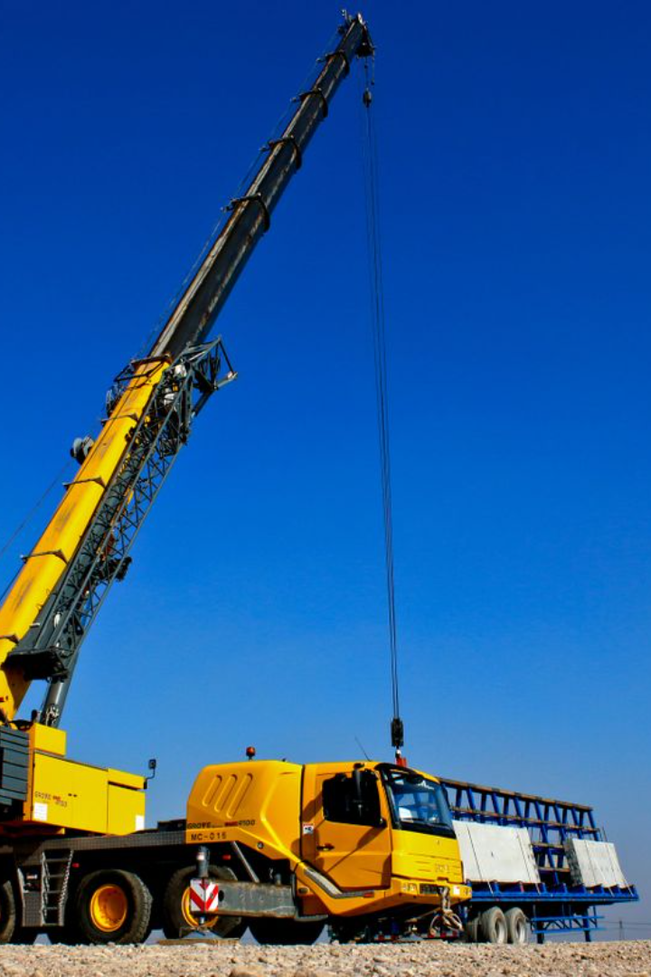
Crane Hoisting Speed
and Load
How does hoisting speed impact the load capacity of a crane?

Slide 2
Hoisting speed plays a crucial role in crane operations, and it affects the stability of the load being lifted. The formula for calculating the maximum allowable hoisting speed is given by:
Max Hoisting Speed=(Load Sway Factor×Crane Hoisting Speed/100​)
The Load Sway Factor is a parameter that accounts for the potential sway or swinging of the load during hoisting. It is important to control load sway to prevent accidents and ensure the safety of the lifting operation.

Slide 3
Sample Example:
Let's say we have a crane with a rated hoisting speed of 10 meters per minute and a Load Sway Factor of 5%. Using the formula, we can calculate the maximum allowable hoisting speed:
Therefore, in this example, the crane's hoisting speed should not exceed 0.5 meters per minute to maintain safe lifting conditions and minimize load sway.
This helps in preventing accidents and ensures the stability of the lifted load. Crane operators need to be aware of and adhere to these speed limits for safe and efficient lifting operations.
Max Hoisting Speed
=(5×10​/100)
=0.5 meters per minute

