Slide 1


HSE Management System

Slide 2
HSE Management System
HSE stands for Health, Safety, and Environment. An HSE Management System is a structured approach used by organizations to manage these crucial aspects of their operations. It involves a framework of policies, procedures, processes, and practices designed to protect human health, ensure workplace safety, and minimize environmental impact.

Slide 3
Key components of an HSE Management System typically include:
Policies and Procedures:
Risk Assessment and Management:
Training and Education:
Compliance and Regulatory Requirements:
Monitoring and Reporting:
Continuous Improvement:
Leadership and Employee Involvement:

Slide 4
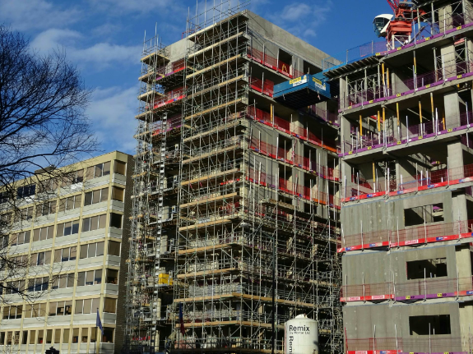
Here's an example of how an HSE Management System might be implemented in a construction company:
XYZ Construction Company
Health, Safety, and Environment (HSE) Management System

Slide 5
1. Policies and Procedures:
Health and Safety Policy: XYZ Construction is committed to ensuring the health, safety, and well-being of all employees, subcontractors, and visitors on its construction sites. This policy outlines the company's zero-tolerance approach towards accidents and emphasizes the importance of compliance with safety protocols.

Slide 6
2. Risk Assessment and Management:
Site Hazard Identification: Before commencing any construction activity, comprehensive risk assessments are conducted to identify potential hazards. These assessments cover risks related to working at heights, electrical safety, heavy machinery operation, and more.

Slide 7
3. Training and Education:
Employee Training Programs: All employees undergo mandatory safety training programs before starting work on-site. Training covers topics such as proper equipment handling, emergency response procedures, and adherence to safety regulations.

Slide 8
4. Compliance and Regulatory Requirements:
Regulatory Compliance Team: A dedicated team ensures that all construction activities adhere to local, state, and federal regulations concerning health, safety, and environmental standards.

Slide 9
5. Monitoring and Reporting:
Incident Reporting System: An incident reporting system is in place to document and investigate any accidents, near-misses, or safety concerns. Regular safety audits are conducted to assess compliance and identify improvement areas.

Slide 10
6. Continuous Improvement:
Lessons Learned Workshops: Regular meetings are held to discuss incidents, identify root causes, and implement corrective actions to prevent future occurrences. Feedback from employees is actively sought to enhance safety practices.

Slide 11
7. Leadership and Employee Involvement:
Safety Committees: Cross-departmental safety committees encourage employee participation in HSE initiatives. Managers lead by example, actively promoting and prioritizing safety measures on-site.

Slide 12
Outcome: XYZ Construction Company's robust HSE Management System aims not only to ensure the safety of its workforce but also to minimize environmental impact. By continuously improving safety protocols and fostering a culture of safety, XYZ Construction strives for incident-free construction operations while complying with all relevant regulations and standards.

