Slide 1

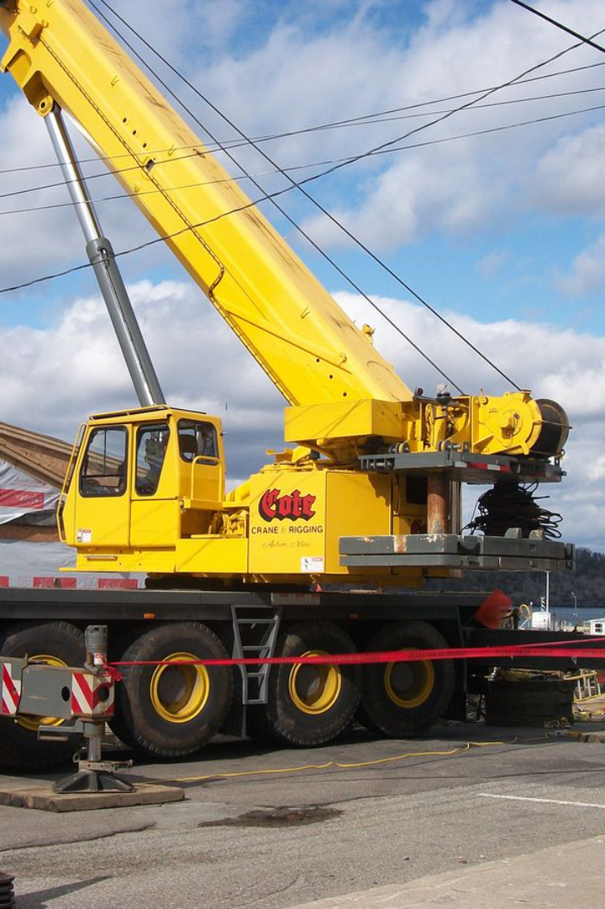
How To Calculate Crane Capacity according to load

Slide 2
Calculating crane capacity involves several factors.
The main components to consider are:
Crane's Rated Capacity: This is the maximum load a crane can lift under ideal conditions specified by the manufacturer. It's often mentioned in the crane's manual or load charts.
Load Weight: Know the weight of the load you intend to lift. Ensure the weight is within the crane's rated capacity.
Boom Length and Angle: The crane's boom length and angle significantly affect its lifting capacity. Longer booms or angles closer to vertical usually decrease the lifting capacity due to leverage.
Radius or Distance from the Crane: The distance from the crane to the load (referred to as the radius) is crucial. As the distance increases, the crane's capacity decreases due to the increased load moment.

Slide 3
To calculate crane capacity, you'll typically use load charts provided by the manufacturer. These charts display the crane's capacity at various boom lengths, angles, and radius. Here's a basic formula for calculating crane capacity:
Crane Capacity = Crane’s Rated Capacity ​/ Boom Length Factor × Boom Angle Factor​ / Radius Factor
Boom Length Factor: Indicates the reduction in capacity as the boom extends. Longer booms reduce capacity.
Boom Angle Factor: Accounts for how the lifting capacity decreases as the boom angle deviates from vertical. Higher angles reduce capacity.
Radius Factor: As the distance from the crane increases, the crane's lifting capacity decreases.
Always ensure you're using the specific load chart for the crane model you're operating. If you're not familiar with crane operations or the calculations involved, it's crucial to consult with a certified crane operator or engineer to ensure safety and accurate calculations. Safety should be the priority when working with heavy equipment like cranes.

Slide 4
let's say you have a crane with a rated capacity of 50 tons. You're planning to lift a load at a certain distance from the crane with a boom length of 100 feet and an angle of 30 degrees from vertical.
First, you'd refer to the crane's load chart to find the boom length factor, boom angle factor, and radius factor for these specific parameters.
Using the formula:
Crane Capacity = Crane’s Rated Capacity / Boom Length Factor × Boom Angle Factor / Radius Factor
Let's assume:
Boom Length Factor = 0.85
Crane Capacity = 50 tons / 0.85​ × 0.75​ / 0.90
Boom Angle Factor = 0.75
Crane Capacity = 58.82 tons × 0.75​ / 0.90
Radius Factor = 0.90
Crane Capacity ≈ 49.02 tons
So, with a boom length of 100 feet and a 30-degree angle, at that specific radius, the crane's effective capacity for that particular lift would be approximately 49.02 tons. Always ensure that the load being lifted does not exceed this calculated capacity to maintain safety during operations.

