Slide 1

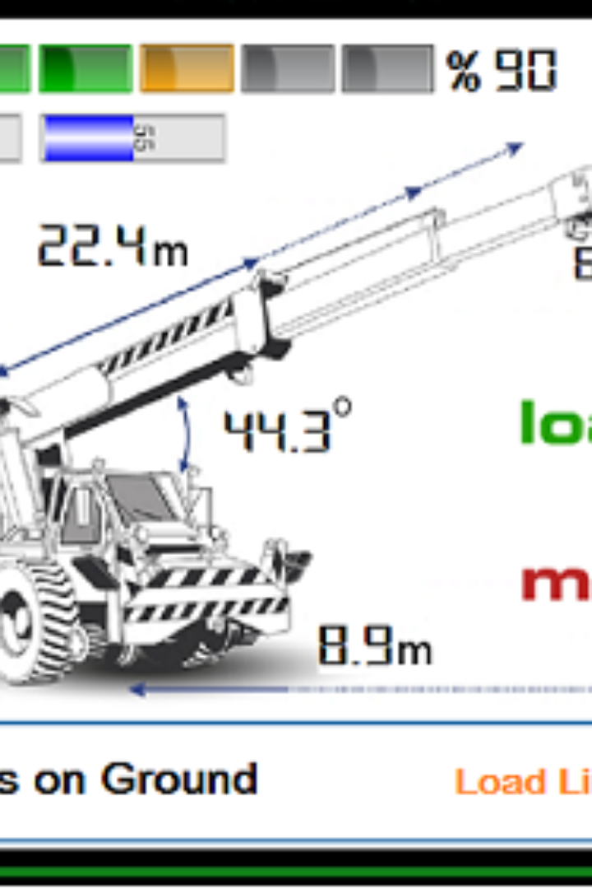

Load Moment Indicator
Why is a Load Moment Indicator important, and how does it enhance crane safety?
Sample Example

Slide 2
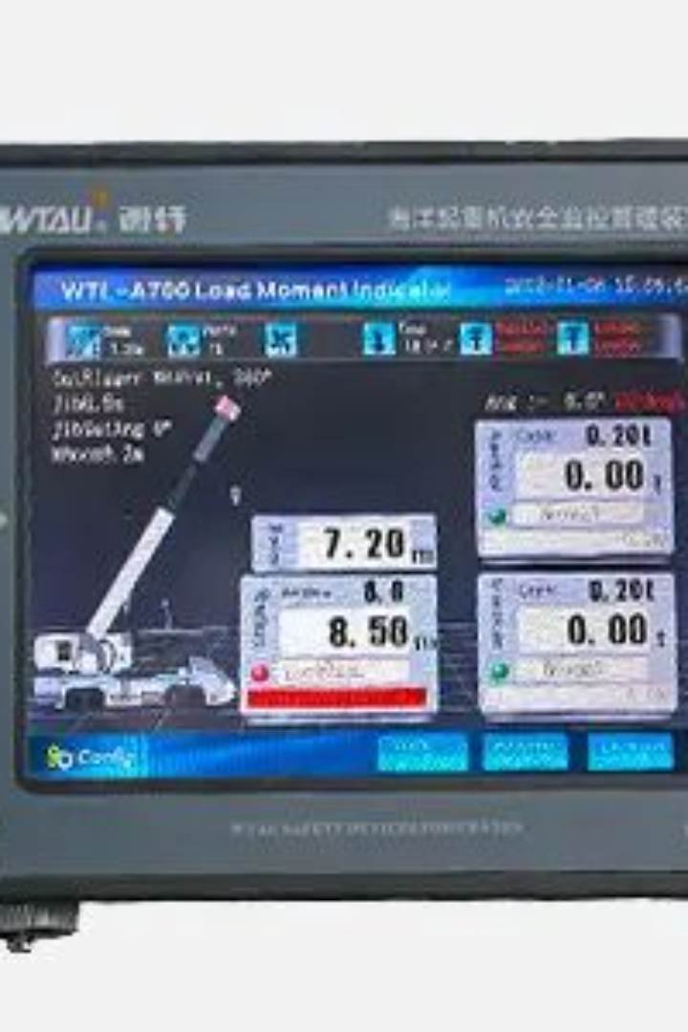
Load Moment Indicator
A Load Moment Indicator (LMI) is crucial for crane safety as it helps prevent overloading, which can lead to accidents and equipment damage. The LMI continuously monitors the load moment, providing real-time information to the crane operator about the load's position and the potential for instability. This enhances safety by ensuring that the crane operates within its rated capacity and load moment limits.

Slide 3
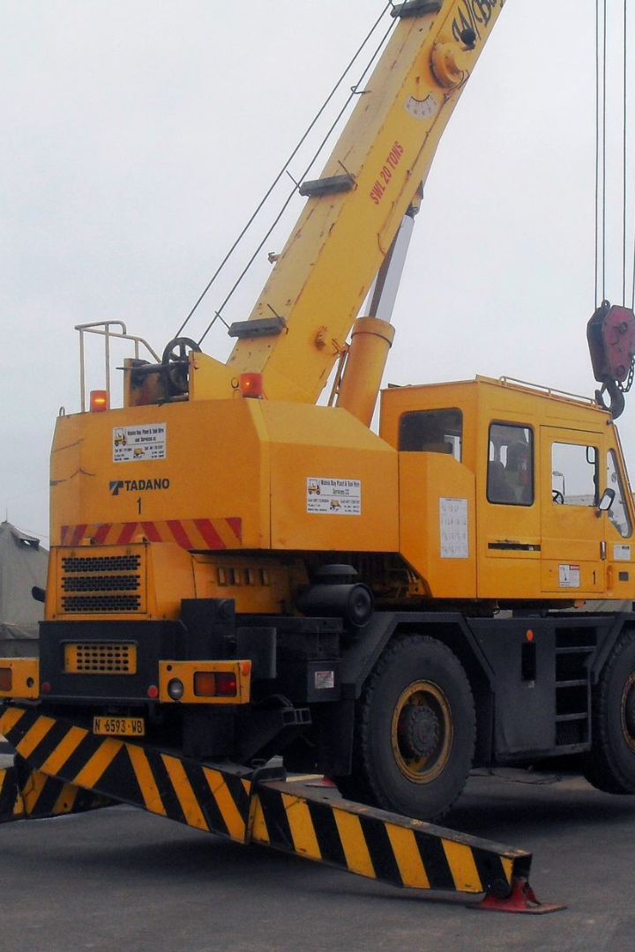
Example
Consider a mobile crane with a rated load moment of 50 tons. The Load Moment Indicator is set to trigger a warning at 45 tons and automatically shut down the crane at 47.5 tons.

Slide 4
Example
If the load moment is calculated during the lift and it is 42.5 tons, the crane operation continues smoothly.
However, if the load moment reaches 46 tons during the lift, the Load Moment Indicator will warn the operator, indicating they are approaching the crane's safe working limits.
If, due to oversight or other factors, the load moment increases to 48 tons, the Load Moment Indicator initiates an automatic shutdown.

Slide 5
In this example, the Load Moment Indicator acts as a critical safety feature, providing timely warnings and intervention to ensure that the crane operates within its safe working limits. This helps prevent accidents, equipment damage, and ensures the safety of both the operator and the surrounding environment, all expressed in tons for a more practical understanding.

