Slide 1

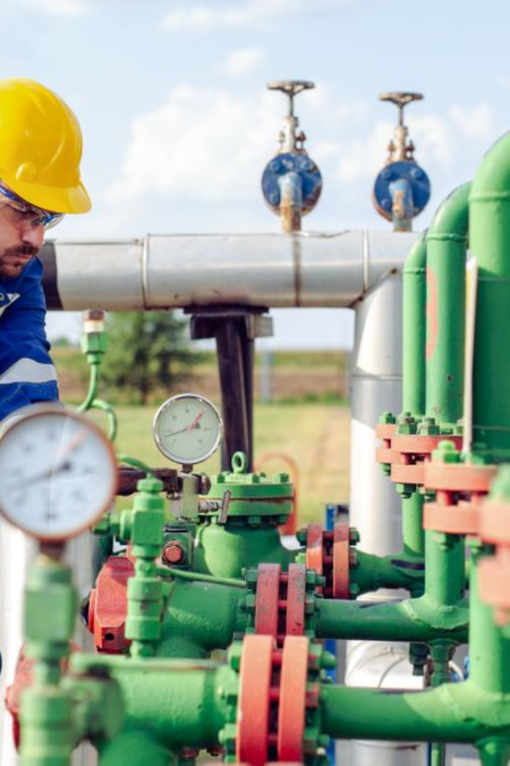
Oil and Gas Industry Hazards and Control Measures

Slide 2
Oil and Gas Industry
The oil and gas industry comes with various hazards, but implementing proper control measures can significantly reduce risks. Here are some common hazards and corresponding control measures:

Slide 3
Fire and Explosions:
Hazard: Highly flammable substances like oil and gas can lead to fires and explosions.
Control Measures: Regular equipment inspections, proper training on handling flammable materials, installation of fire detection systems, and emergency response planning.

Slide 4
Exposure to Harmful Substances:
Hazard: Workers may be exposed to toxic chemicals and gases.
Control Measures: Personal protective equipment (PPE) such as respirators, proper ventilation systems, and regular monitoring of air quality.

Slide 5
Physical Hazards:
Hazard: Working with heavy machinery, high-pressure systems, and lifting operations pose physical risks.
Control Measures: Training on equipment operation and safety procedures, maintenance schedules for machinery, and implementation of safety barriers or guards.

Slide 6
Falls and Working at Heights:
Hazard: Working on elevated platforms or structures increases the risk of falls.
Control Measures: Safety harnesses, guardrails, proper scaffolding, and regular safety inspections of elevated work areas.

Slide 7
Transportation Risks:
Hazard: Accidents during transportation of oil and gas materials.
Control Measures: Proper driver training, vehicle maintenance, adherence to traffic regulations, and regular safety checks on transportation vehicles.

Slide 8
Natural Hazards:
Hazard: Exposure to natural elements like extreme weather conditions.
Control Measures: Monitoring weather forecasts, evacuation plans for severe weather events, and implementing shelters or safe zones.

Slide 9
Health Risks:
Hazard: Long-term health effects from exposure to chemicals and stressful working conditions.
Control Measures: Regular health screenings, ergonomic assessments, and promoting a culture of health and safety awareness.

Slide 10
Equipment Failure:
  Hazard: Malfunction or failure of machinery and equipment.
  Control Measures: Routine equipment inspections, predictive maintenance strategies, and prompt repairs or replacements as needed.

Slide 11
Workplace Stress and Fatigue:
Hazard: High-pressure environments leading to fatigue and decreased alertness.
Control Measures: Managing work schedules to prevent fatigue, providing rest periods, and fostering a supportive work environment.

Slide 12
Security Risks:
Hazard: Potential security threats to facilities and personnel.
Control Measures: Implementing security protocols, access controls, surveillance systems, and regular security assessments.

Slide 13
Implementing a comprehensive safety program that includes training, regular inspections, hazard identification, and proper emergency response planning is crucial in mitigating these hazards within the oil and gas industry.

