Slide 1

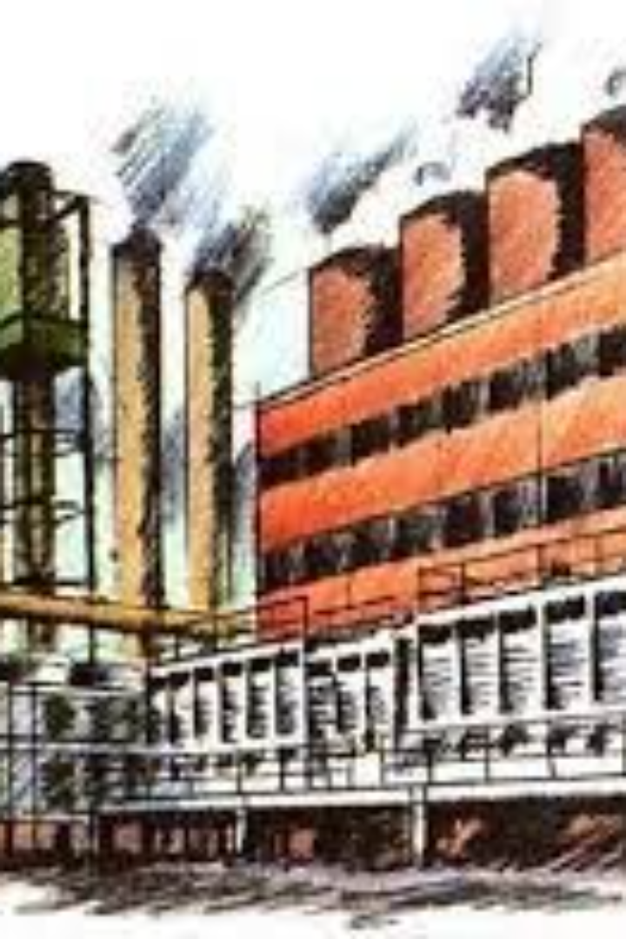
Provision of Factory Act 1948
Regarding Safety and Welfare of workers?
Employment of Young Persons

Slide 2
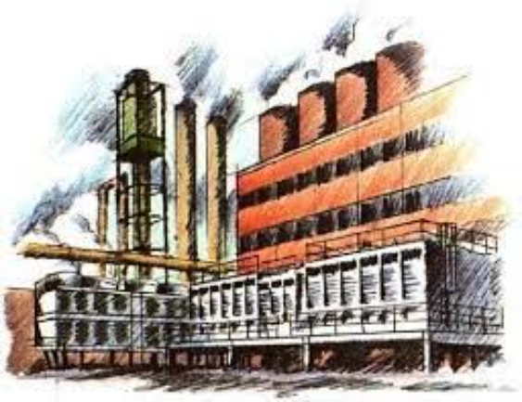
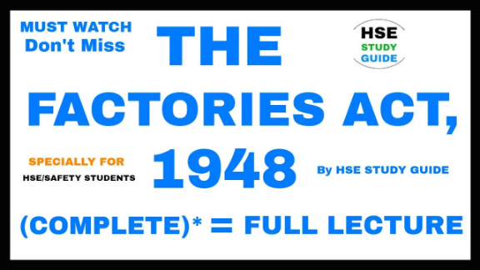
The Factories Act of 1948 in India contains provisions related to the safety and welfare of workers in factories.
Some key provisions include:

Slide 3
Safety Measures:
The Act mandates the provision of safety measures such as fencing of machinery, work on or near machinery in motion, devices for preventing accidents, and proper ventilation.
Section 21: Fencing of machinery.
Section 22: Work on or near machinery in motion.
Section 23: Precautions for preventing accidents.
Section 24: Devices for preventing access to dangerous parts.
Section 25: Maintenance of buildings and machinery.

Slide 4
Welfare Facilities:
It emphasizes the provision of welfare facilities like clean drinking water, sanitary facilities, first aid appliances, and canteen facilities in factories.
Section 42: Drinking water.
Section 43: Facilities for storing and drying clothing.
Section 44: First aid appliances.
Section 45: Canteens.

Slide 5
Working Hours and Overtime:
The Act regulates the working hours of adult workers, and it also prescribes rules for overtime work, ensuring that workers are not overburdened with excessive working hours.
Section 51: Weekly hours.
Section 54: Prohibition of overlapping shifts.
Section 59: Extra wages for overtime work.

Slide 6
Employment of Young Persons:
The Act defines a "young person" as a person who is between 15 and 18 years of age. It imposes restrictions on the employment of young persons in certain types of work and outlines conditions for their employment.
Section 2(ee): Definition of "young person" (a person who is between 15 and 18 years of age).
Section 67: Prohibition of employment of young children.
Section 68: Non-adult workers to carry tokens.
Section 2(a): "adult" means a person who has completed his eighteenth year of age.
Section 71: Certificate of fitness for young persons.

Slide 7
Weekly Holidays:
It ensures that every worker is entitled to at least one rest day per week.
  Section 52: Weekly holidays.

Slide 8
Employment of Young Persons:
According to the Factories Act of 1948, certain types of work are restricted for young persons, who are individuals aged between 15 and 18 years. The restrictions aim to protect their health and well-being, as well as ensure that their employment does not interfere with their education. The specific restrictions on the employment of young persons include:
Section 67(1): Prohibition of certain types of work for young persons:
  No young person shall be required or allowed to work in any factory at any of the following occupations:
    Handling of flammable or explosive substances.
    Cleaning or lubricating moving parts of machinery.
    Adjusting any belt at belt-driven machinery.
    A work that involves exposure to excessive noise levels.

