Slide 1

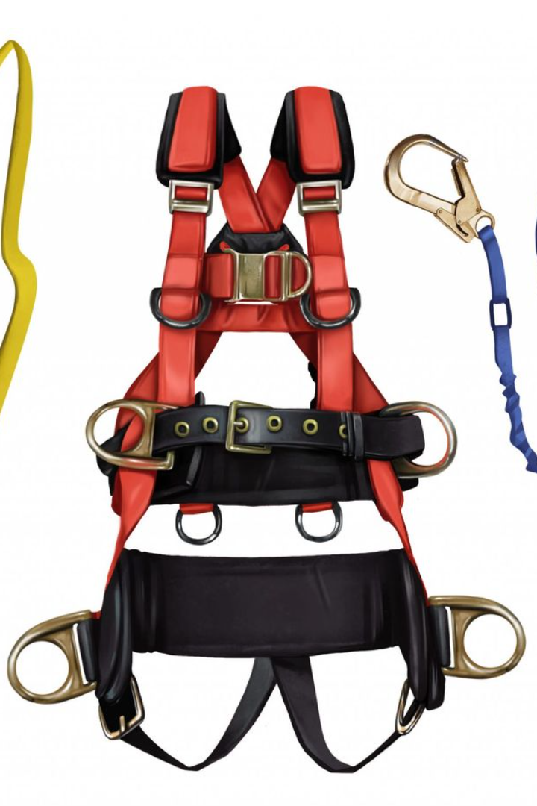
Safety Harness
Safe Working Load
Breaking Strength of harness
Safety Margin
Safety Factor

Slide 2
SWL (Safe Working Load)
SWL refers to the maximum load a safety harness is designed to support during normal use.
Example: If a safety harness has a SWL of 1 ton, it means the harness is designed to safely support loads up to 1 ton during regular use.

Slide 3
Breaking Strength of Harness
This is the maximum load the safety harness can withstand before it fails.
Example: If the breaking strength of a safety harness is 5 tons, the harness will start to fail when the load exceeds 5 tons.

Slide 4
Safety Margin
Safety margin is the difference between the SWL and the breaking strength of the harness. It provides an additional buffer for unexpected forces or stresses.
Example: If a safety harness has a SWL of 1 ton and a breaking strength of 5 tons, the safety margin is 4 tons (5 tons - 1 ton).

Slide 5
Safety Factor
Safety factor is the ratio of breaking strength to the SWL. It indicates how much stronger the harness is compared to the maximum expected load.
Example: If the breaking strength is 5 tons and the SWL is 1 ton, the safety factor is 5 (5 tons / 1 ton).

Slide 6
Safety Harness:
Example:
Safety Harness SWL: 1 ton
Breaking Strength: 5 tons
Safety Margin: 4 tons (Breaking Strength - SWL)
Safety Factor: 5 (Breaking Strength / SWL)
So, if the actual load applied to the harness is 1 ton, it is within the safe working load. The safety margin is 4 tons, providing an additional buffer. The safety factor of 5 indicates that the harness is five times stronger than the expected load.

Slide 7
Note : It's important to note that the specifications for a safety harness can vary based on the manufacturer, model, and intended use. These values need to be obtained from the product's documentation or the manufacturer.
Safe Working Load (SWL):
  Example: 1.5 tons
Breaking Strength of Harness:
  Example: 7.5 tons
Safety Margin:
  Example: 6 tons (Breaking Strength - SWL)
Safety Factor:
  Example: 5 (Breaking Strength / SWL)

