Slide 1

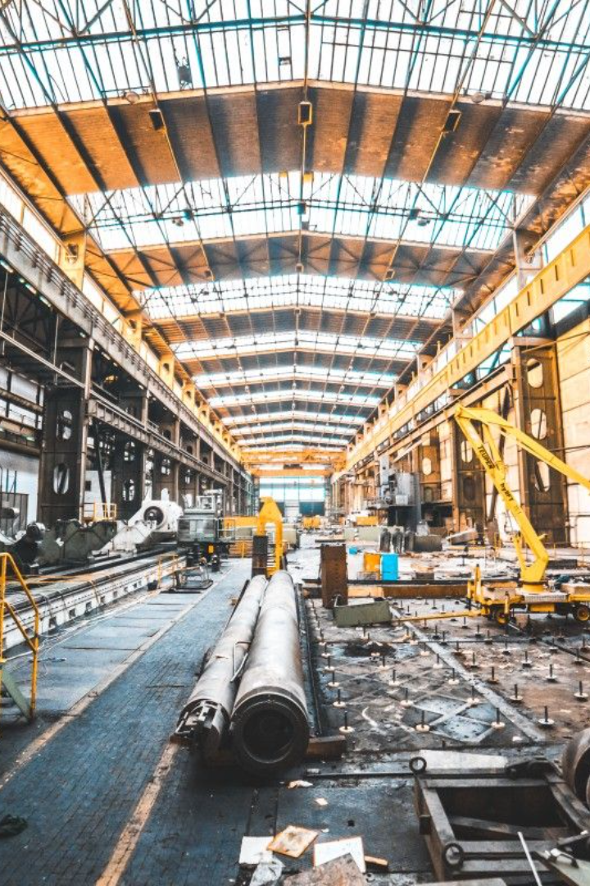
Steel Manufacturing Industry
Hazards and Precautions

Slide 2
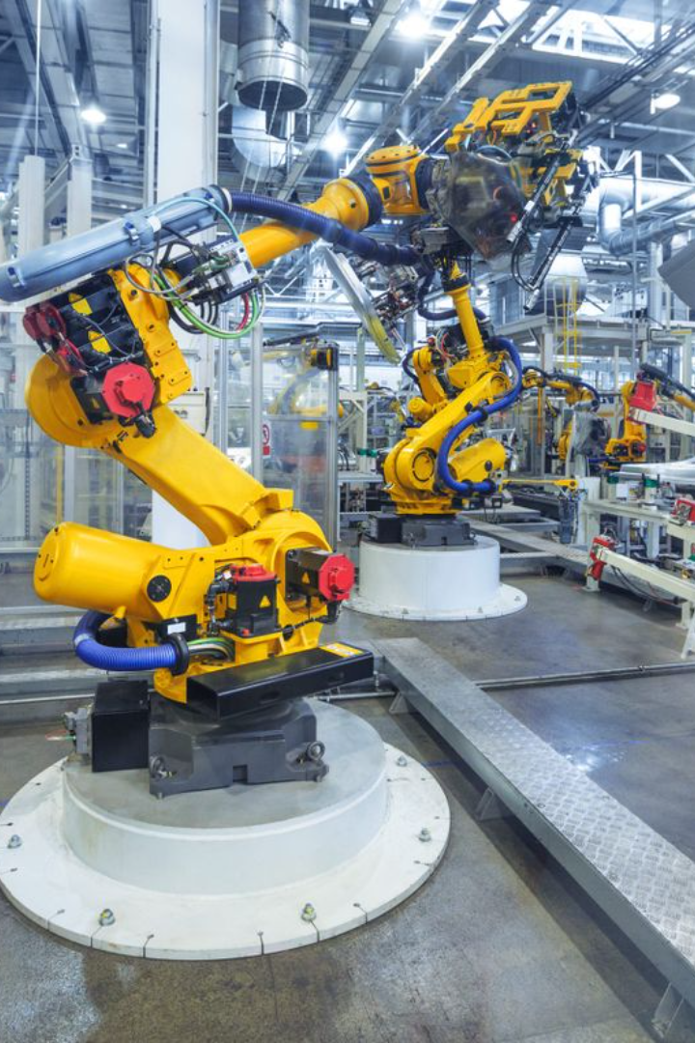
The steel manufacturing industry involves various hazards that can pose risks to the health and safety of workers. It's crucial for employees and employers alike to be aware of these hazards and implement precautionary measures to mitigate potential risks. Here are some common hazards in the steel manufacturing industry and corresponding precautions:

Slide 3

Heavy Machinery and Equipment:
Hazard: Workers can be at risk of injuries from heavy machinery, such as cranes, forklifts, and rolling mills.
Precautions: Implement strict training programs for equipment operators, provide personal protective equipment (PPE) like helmets and steel-toed boots, and clearly mark designated pedestrian areas.

Slide 4
Noise:
Hazard: Steel manufacturing processes can generate high levels of noise, leading to hearing damage over time.
Precautions: Provide hearing protection equipment, conduct regular noise assessments, and implement engineering controls like noise barriers.

Slide 5
Chemical Exposure:
Hazard: Workers may be exposed to chemicals during various stages of steel production, including cleaning, coating, and processing.
Precautions: Ensure the use of proper personal protective equipment (PPE) such as gloves, masks, and aprons. Provide training on safe handling and storage of chemicals, and implement proper ventilation systems.

Slide 6
High Temperatures:
Hazard: Steel manufacturing involves working with molten metal and high-temperature processes.
Precautions: Provide heat-resistant PPE, such as fire-resistant clothing and face shields. Implement cooling measures, like shaded rest areas, and monitor heat stress among workers.

Slide 7
Falling Objects:
  Hazard: Heavy materials or tools can fall from elevated platforms, posing a risk to workers below.
  Precautions: Encourage the use of tool lanyards, provide safety nets, and enforce strict guidelines for securing materials on elevated platforms.

Slide 8
Confined Spaces:
Hazard: Some steel manufacturing processes may involve work in confined spaces, increasing the risk of accidents and limited access.
Precautions: Implement confined space entry procedures, provide proper training, and ensure adequate ventilation in confined spaces. Use gas detectors to monitor air quality.

Slide 9
Dust and Fumes:
Hazard: Fine particulate matter and fumes generated during steel manufacturing processes can pose respiratory hazards.
Precautions: Implement dust control measures, provide respiratory protection where necessary, and conduct regular air quality monitoring. Encourage the use of local exhaust ventilation systems.

Slide 10
Machine Guarding:
Hazard: Improperly guarded machinery can lead to accidents, such as entanglement or amputation.
Precautions: Ensure all machinery is properly guarded, conduct regular inspections, and provide training on the safe operation of equipment.

Slide 11
Regular safety training, hazard assessments, and the implementation of engineering controls are essential to maintaining a safe working environment in the steel manufacturing industry. Employers should actively involve employees in safety programs to foster a culture of awareness and responsibility.

