Slide 1

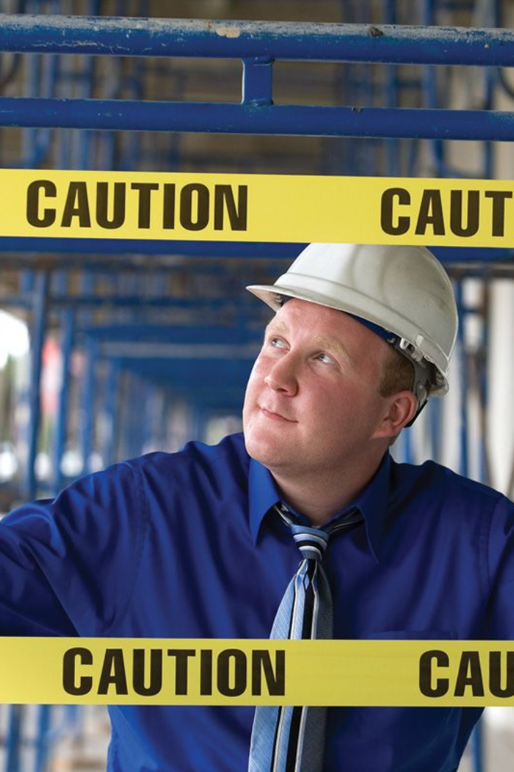
Top 10
Safety Rules of
Oil & Gas Industry

Slide 2
Personal Protective Equipment (PPE)
Personal Protective Equipment (PPE): Always wear appropriate PPE - hard hats, safety goggles, gloves, and steel-toed boots - to protect against potential hazards.

Slide 3
Hazard Communication
Hazard Communication: Understand and follow all safety data sheets (SDS) and labels for chemicals and substances used in the workplace.

Slide 4
Confined Space Entry
Confined Space Entry: Adhere to strict protocols when entering confined spaces, such as tanks or vessels, including proper ventilation and monitoring for hazardous gases.

Slide 5
Lockout/Tagout (LOTO)
Lockout/Tagout (LOTO): Use LOTO procedures to control hazardous energy sources and prevent unexpected equipment start-up during maintenance or repairs.

Slide 6
Fall Protection
Fall Protection: Employ proper fall protection measures - guardrails, harnesses, and safety nets - when working at heights to prevent falls.

Slide 7
Fire Safety
Fire Safety: Follow fire safety protocols, including proper storage of flammable materials, regular equipment inspections, and knowledge of firefighting procedures.

Slide 8
Equipment Safety
Equipment Safety: Conduct regular equipment inspections and maintenance to ensure safe operation and promptly report any malfunctions or defects.

Slide 9
Safe Driving
Safe Driving: Adhere to safe driving practices, obey speed limits, and follow traffic rules, especially when operating vehicles or heavy machinery.

Slide 10
Emergency Preparedness
Emergency Preparedness: Be familiar with emergency procedures, evacuation routes, and the location of emergency equipment like fire extinguishers and first aid kits.

Slide 11
Training and Awareness
Training and Awareness: Stay updated on safety training and procedures, communicate potential hazards to colleagues, and actively participate in safety meetings and drills.

Slide 12
These rules are crucial in creating a safer working environment in the oil and gas industry by mitigating risks and promoting a culture of safety among workers.

