Slide 1

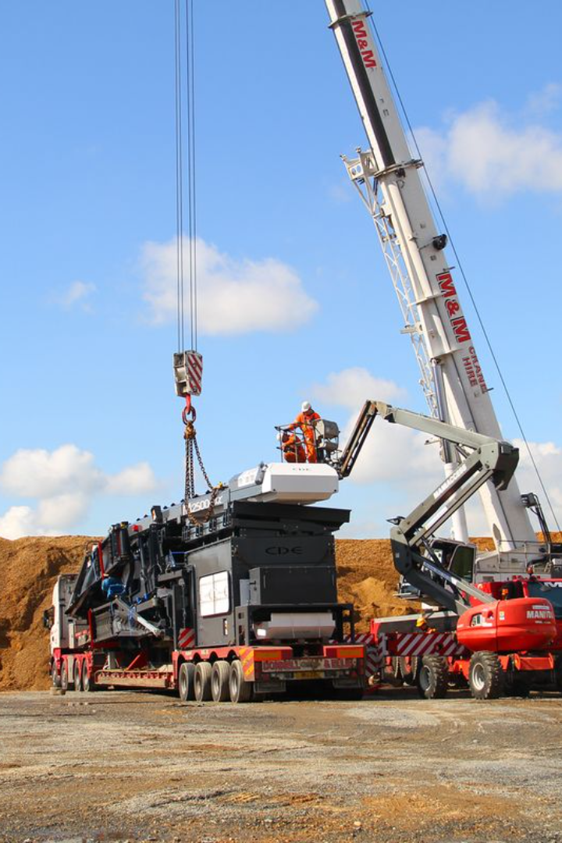
Safe Working Load (SWL)
= 5.75 tons
Maximum allowed utilization = 75%
Weight Lifted = 3 tons
Utilization Factor %?

Slide 2
Utilization factor
The utilization factor is a measure of the efficiency or capacity utilization of a system or equipment. It is often expressed as a percentage and represents the ratio of the actual used capacity to the maximum allowable capacity. In the context of lifting equipment, the utilization factor is used to determine how much of the equipment's safe working load (SWL) is being utilized during a particular operation.
Here's the general formula for the utilization factor:
Utilization Factor % = (Actual Used Capacity / Maximum Allowable Capacity​) × 100

Slide 3
To find the lifting load utilization factor percentage, you can use the following formula:
Utilization Factor % = (Weight Lifted / Safe Working Load) × 100
Given:
Safe Working Load (SWL) = 5.75 tons
Maximum allowed utilization = 75%
Weight Lifted = 3 tons
Substitute these values into the formula:
Utilization Factor % = (3 tons / 5.75 tons​) × 100
Calculate the result:
Utilization Factor % = (0.5217 / 1) × 100 ≈ 52.17%
Therefore, the utilization factor is approximately 52.17%.
This means that the crane is operating at 52.17% of its maximum capacity during this lifting operation. In the context of lifting equipment, it's important to adhere to specified utilization limits to ensure safe and efficient operations. if the maximum allowed utilization is 75%, exceeding this limit may pose a safety risk and could lead to equipment failure or accidents.

