Slide 1
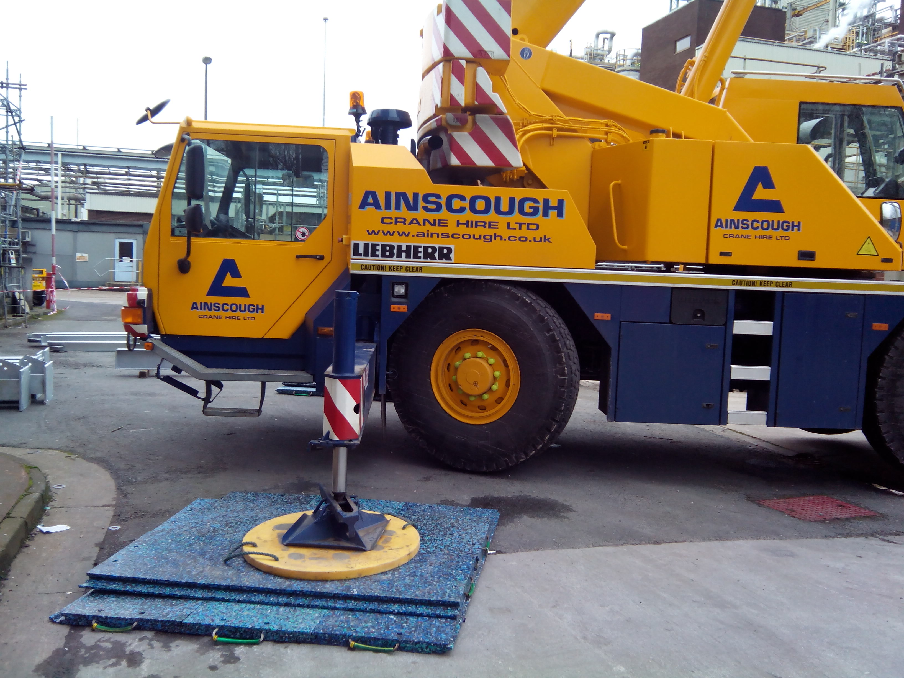

Load Moment (LM)
= 10 tons
Outrigger Length
= 10 feet
Now Calculate
Outrigger Load Calculations?

Slide 2
Load Moment (LM): The product of the load weight and its distance from the center of rotation (usually the center of the crane). It is a measure of the turning force generated by the load.
Load Moment (LM) = Load Weight × Load Radius
Outrigger Length: The horizontal distance from the center of rotation to the point where the outrigger contacts the ground.
Outrigger Load: The force exerted on each outrigger to counteract the load moment and maintain stability. The formula for outrigger load is:
Outrigger Load = Load Moment / Outrigger Length

Slide 3
Given:
Load Moment (LM) = 10 tons
Outrigger Length = 10 feet
Outrigger Load Calculation:
Outrigger Load = Load Moment / Outrigger Length
Outrigger Load = 10 tons / 10 feet = 1 ton per foot
In this example, the calculated outrigger load is 1 ton per foot.
This means that for every foot of outrigger extension, the force exerted on the outrigger to maintain stability is 1 ton.
It's important to compare the calculated outrigger load with the crane's outrigger load capacity specified by the manufacturer. The outrigger load capacity should be higher than the calculated outrigger load to ensure safe crane operations and stability. Always follow manufacturer guidelines, load charts, and safety procedures when performing such calculations.

