Slide 1

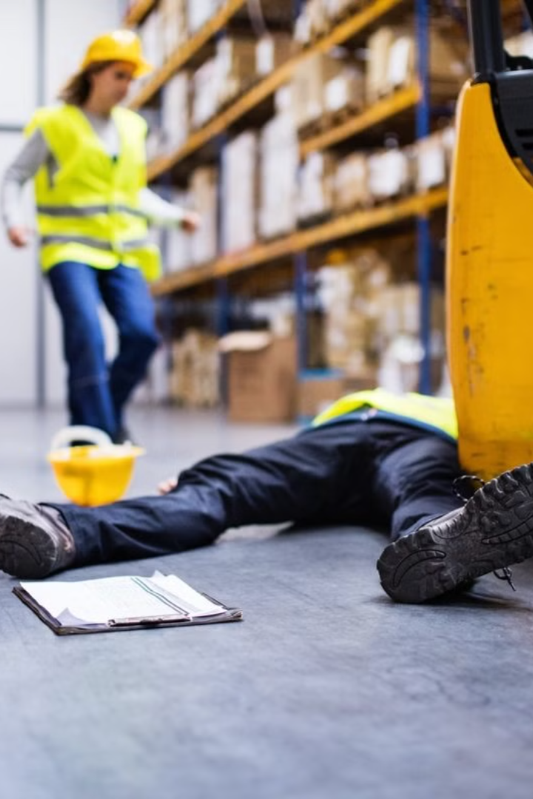
What should I do as a safety officer if any accident or incident happened at site?
How to investigate accident or incident
at site?
Why accident investigation records
are kept?

Slide 2
As a safety officer, if an accident or incident occurs at the site, follow these steps:
a) Immediate Response:
b) Documentation:
Example for Immediate Response:
Example for Documentation:
If a worker falls from a height on a construction site, as a safety officer, your immediate response would involve:
After the incident, you would document the details:
Recording the date, time, and location of the fall.
Calling for emergency medical assistance.
Noting the extent of the injuries and the type of first aid provided.
Providing first aid to the injured worker.
Isolating the area to prevent others from accessing the potentially dangerous zone.
Taking photographs of the scene, especially focusing on the location of the fall and any contributing factors.
Notifying relevant authorities and senior management about the incident.
Collecting witness statements and any other relevant information.

Slide 3
As a safety officer, if an accident or incident occurs at the site, follow these steps:
c) Notify Authorities:
d) Preserve the Scene:
Example for Notifying Authorities:
Example for Preserving the Scene:
In this scenario, you would report the incident to the appropriate authorities such as the Occupational Safety and Health Administration (OSHA) or relevant regulatory bodies in your jurisdiction. Timely reporting ensures compliance with legal requirements and allows for a thorough investigation.
To preserve the scene, you would:
Instruct workers not to disturb the area.
Secure any equipment involved in the incident.
Provide necessary information to emergency responders but refrain from altering the scene until investigators arrive.
e) Communication:
Keep affected parties informed about the situation.
Communicate with relevant personnel regarding any changes in work processes.

Slide 4
Accident Investigation:
a) Establish an Investigation Team:
b) Collect Information:
Example for Establishing an Investigation Team:
Example for Collecting Information:
The investigation team interviews the injured worker, witnesses, and reviews records related to the incident. They gather information on the worker's experience, the condition of safety equipment, and any deviations from established procedures.
You assemble a team consisting of a safety specialist, an operations expert, and possibly an external consultant with expertise in fall prevention to conduct a comprehensive investigation.

Slide 5
Accident Investigation:
c) Root Cause Analysis:
d) Recommend Corrective Actions:
Example for Root Cause Analysis:
Example for Recommending Corrective Actions:
Using the "5 Whys," the team discovers that the worker fell because the safety harness was not properly secured. Further analysis reveals that inadequate training and a lack of regular equipment inspections contributed to the failure.
Based on the findings, the team recommends corrective actions such as:
Enhanced training programs on proper use of safety equipment.
Regular inspections and maintenance of safety harnesses.
Implementing a checklist system to ensure proper safety measures are followed before starting work at heights.
e) Documentation:
Example for Documentation of Investigation:
A detailed report is created, outlining the incident, investigation process, root causes, and recommended corrective actions. This report is shared with management, regulatory authorities, and relevant stakeholders.

Slide 6
Importance of Accident Investigation Records:
a) Legal Compliance:
b) Continuous Improvement:
Helps organizations comply with legal requirements for reporting and investigating accidents.
Enables the identification of systemic issues and areas for improvement in safety procedures.
Example for Continuous Improvement:
The organization uses the incident report and recommendations to improve overall safety protocols, providing additional training to workers and implementing changes to prevent similar incidents in the future.
c) Insurance and Liability:
d) Training and Prevention:
Provides documentation for insurance claims and helps determine liability in case of legal proceedings.
Offers valuable insights for training programs to enhance safety awareness and prevent future incidents.

