Slide 1

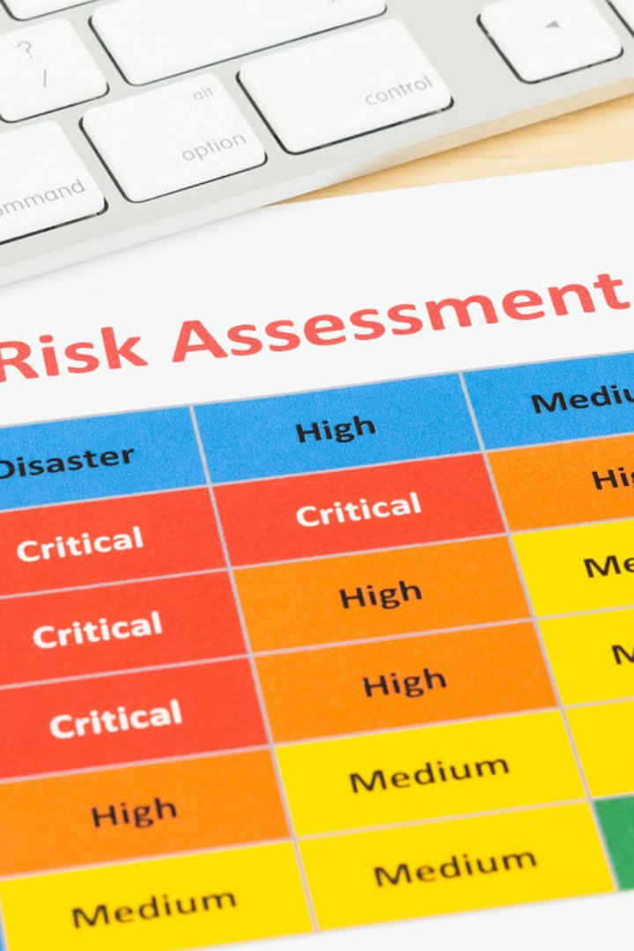
Risk Assessment
How To Calculate it?
Explained with Example

Slide 2
Risk Assessment
Risk assessment is a systematic process of identifying, analyzing, and evaluating potential hazards or risks associated with a particular activity, process, or situation. It aims to determine the likelihood and severity of these risks and implement appropriate measures to control or mitigate them. Risk assessment is crucial in various fields such as occupational safety, environmental management, project planning, and healthcare.

Slide 3
To calculate risk assessment, you typically follow these steps:
Identify hazards: Identify all potential hazards associated with the activity or situation. This involves observing, inspecting, and reviewing relevant information.
Assess risks: Evaluate the likelihood and consequences of each identified hazard. Determine the level of risk by considering factors such as frequency of exposure, potential harm, and existing control measures.
Control measures: Develop and implement control measures to eliminate or reduce risks to an acceptable level. This may involve engineering controls, administrative controls, or personal protective equipment (PPE).
Review and monitor: Regularly review and monitor the effectiveness of control measures. Update the risk assessment as needed to address any changes or new hazards.

Slide 4
Here's a sample example of a risk assessment for a work at height activity:
Work at Height Risk Assessment Example:
1. Identify Hazards:
Falling from height
Objects falling from height onto workers or pedestrians below
Structural instability of platforms or scaffolding
Adverse weather conditions (e.g., wind, rain)

Slide 5
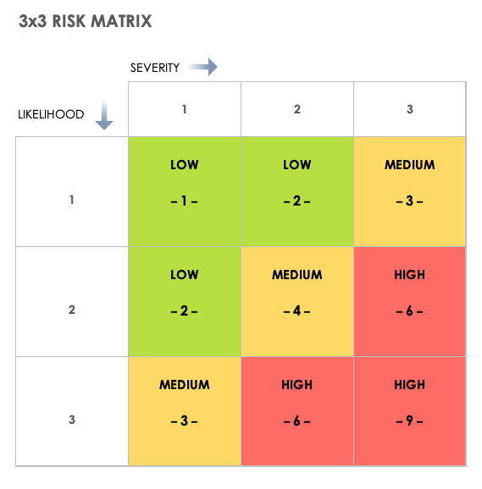
Here's a sample example of a risk assessment for a work at height activity:
Work at Height Risk Assessment Example:
2. Assess Risks:
Likelihood:
  High likelihood of falling due to working at elevated levels.
  Medium likelihood of objects falling if proper precautions are not taken.
  Low likelihood of structural instability if proper maintenance and inspections are conducted.
  Likelihood of adverse weather conditions depends on location and season.
Consequences:
  Falling from height can result in severe injury or fatality.
  Objects falling can cause injuries to workers or pedestrians below.
  Structural instability can lead to collapse and potential injuries.
  Adverse weather conditions may increase the risk of slips and falls.

Slide 6
Here's a sample example of a risk assessment for a work at height activity:
Work at Height Risk Assessment Example:
3. Control Measures:
Use of appropriate fall protection equipment such as harnesses, guardrails, or safety nets.
Secure tools and materials to prevent objects from falling.
Regular inspections and maintenance of platforms, scaffolding, and ladders.
Monitor weather forecasts and reschedule work if adverse conditions are anticipated.
Provide training to workers on proper procedures and safety precautions.

Slide 7
Here's a sample example of a risk assessment for a work at height activity:
Work at Height Risk Assessment Example:
4. Review and Monitor:
Regularly inspect equipment and work areas for any hazards.
Conduct toolbox talks or safety meetings to reinforce safe practices.
Investigate and address any incidents or near misses promptly.
Update risk assessment as necessary based on changes in conditions or procedures.

