Slide 1

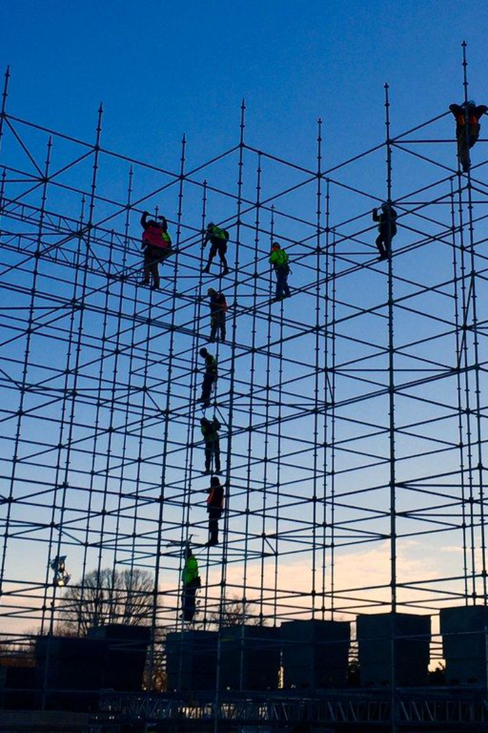
How to Calculate
Scaffolding
Safe Working Load (SWL) Capacity?

Slide 2
Scaffold Components:
Assume you have a scaffold system with standard tubes, couplers, and wooden boards. Refer to the manufacturer's specifications for each component.

Slide 3
Manufacturer's Specifications:
The specifications indicate that each standard tube has a maximum load capacity of 4,000 pounds (lb), each coupler can support 2,000 pounds, and the wooden boards have a load capacity of 50 pounds per square foot.
Conversion:
Tubes: 4,000 lb x 0.453592 kg/lb = 1,814.37 kg
Couplers: 2,000 lb x 0.453592 kg/lb = 907.18 kg
Wooden boards: 50 lb/square foot x 0.453592 kg/lb = 22.68 kg/square foot

Slide 4
Scaffold Configuration:
The scaffold is configured with 10 standard tubes, 20 couplers, and wooden boards covering an area of 200 square feet.

Slide 5
Calculate Component Loads:
Tubes: 10 tubes x 1,814.37 kg/tube = 18,143.7 kg
Couplers: 20 couplers x 907.18 kg/coupler = 18,143.6 kg
Wooden boards: 200 square feet x 22.68 kg/square foot = 4,536 kg

Slide 6
Total Load:
Total Load = Tubes Load + Couplers Load + Boards Load
Total Load = 18,143.7 kg + 18,143.6 kg + 4,536 kg = 40,823.3 kg

Slide 7
Factor of Safety (Assuming 5:1):
Factor of Safety (Assuming 5:1): This means that the calculated load-carrying capacity (Total Load) is divided by a factor of 5. The resulting value is considered the Safe Working Load (SWL), which represents the maximum load the scaffold system can safely support.
Apply a factor of safety, let's say 5:1.
SWL = Total Load / Factor of Safety
SWL = 40,823.3 kg / 5 = 8,164.66 kg
The factor of safety provides a buffer against uncertainties, variations in loads, and potential dynamic forces, ensuring that the structure remains within a safe operating range. The higher the factor of safety, the greater the margin of safety built into the design.

