Slide 1

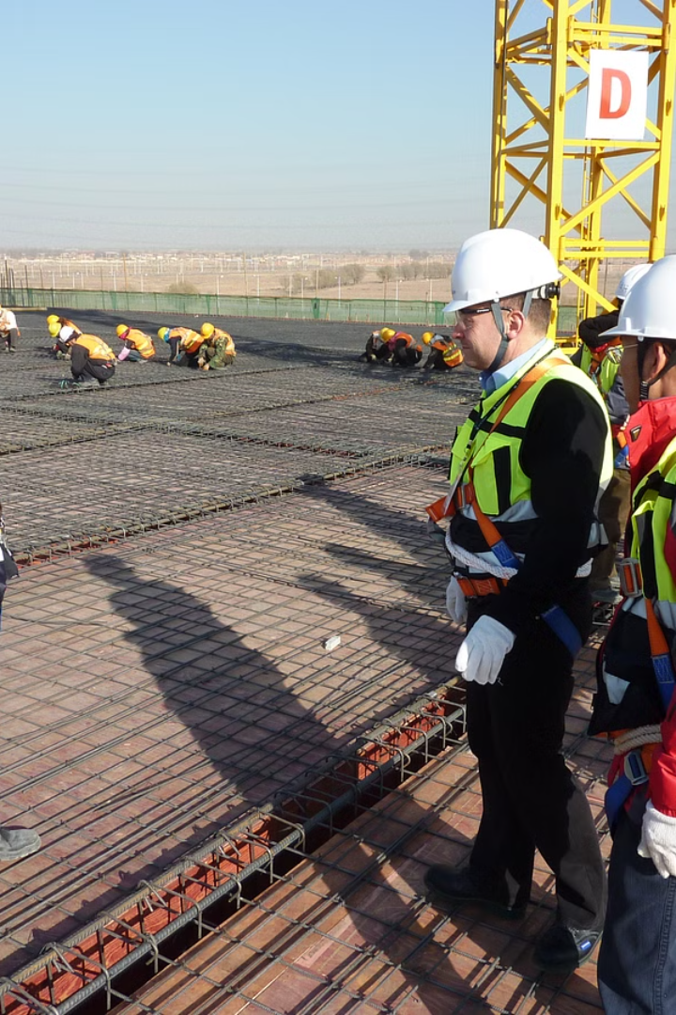
Safety Interaction
Safety Officer

Slide 2
The Importance of Safety Interaction:
Communication: Clear and concise communication is essential in conveying safety information. Safety officers must effectively communicate policies, procedures, and potential hazards to employees at all levels. Regular safety meetings, toolbox talks, and open-door policies facilitate an environment where employees feel comfortable discussing safety concerns.
Engagement: Actively engaging with employees enhances their awareness and commitment to safety. Regular safety drills, training sessions, and hands-on demonstrations contribute to a proactive safety culture. Encouraging employees to actively participate in identifying potential hazards and suggesting safety improvements fosters a sense of ownership.

Slide 3
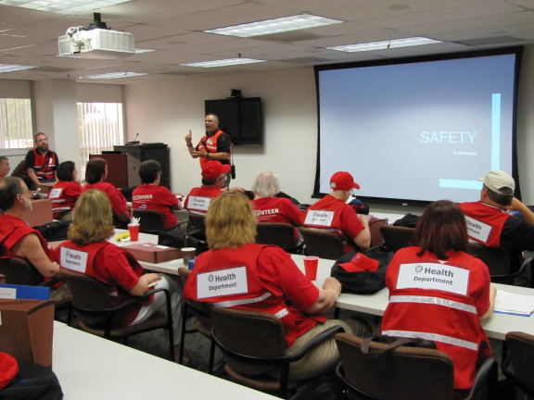
Sample Example of Safety Interaction:
Consider a manufacturing facility where a safety officer, let's call him John, is committed to promoting a strong safety culture.

Slide 4
Regular Safety Meetings: John conducts weekly safety meetings where he discusses the importance of using proper PPE in the manufacturing area. He shares recent incident reports, emphasizing the lessons learned and preventive measures to be taken. This open forum allows employees to ask questions and express concerns.
Hands-On Training: Recognizing the importance of practical knowledge, John organizes hands-on training sessions for operating machinery safely. Employees receive personalized guidance on correct procedures, and John ensures that everyone is comfortable using the equipment before regular operations resume.
Safety Walkthroughs: John conducts regular safety walkthroughs to identify and address potential hazards. During these walkthroughs, he engages with employees on the floor, encouraging them to report any safety issues they observe. This interactive approach not only identifies risks but also empowers employees to actively contribute to the safety of the workplace.

