Slide 1


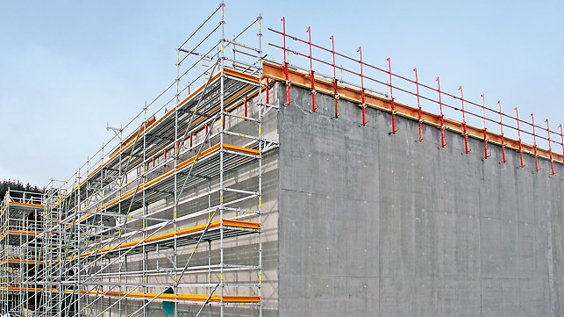
Scaffolding Technical specification
As per IS and OSHA Standard
Toe board, Mid rail, Top rail, Platform, Guardrail

Slide 2
Toe Board:
Indian Standard: Toe boards should be a minimum of 100 mm (4 inches) in height and securely fixed to the scaffold.
OSHA Standard: Toe boards must be at least 3.5 inches (89 mm) in height and securely fastened along the edge of the scaffold platform.

Slide 3
Mid Rail:
Indian Standard: Mid rails are required at approximately mid-height of the guardrails, securely attached to provide additional protection.
OSHA Standard: Mid rails must be installed halfway between the top rail and the platform surface.

Slide 4
Top Rail
Indian Standard: The top rail height should be between 950 mm to 1050 mm (37 to 41 inches) above the platform surface.
OSHA Standard: The top rail must be installed at a height between 38 inches (965 mm) and 45 inches (1143 mm) above the scaffold platform.

Slide 5
Platform:
Indian Standard: Scaffold platforms must be constructed with suitable materials to support the intended load, with a minimum width of 600 mm (24 inches).
OSHA Standard: Scaffold platforms must have a minimum width of 18 inches (457 mm) unless specifically designed for a particular purpose.

Slide 6
Guardrail:
Indian Standard: Guardrails must be installed along all open sides and ends of the scaffold platform, with a minimum height of 950 mm (37 inches).
OSHA Standard: Guardrails must be installed along all open sides and ends of the scaffold platform at a height of 38 inches (965 mm) above the platform surface.

