Slide 1

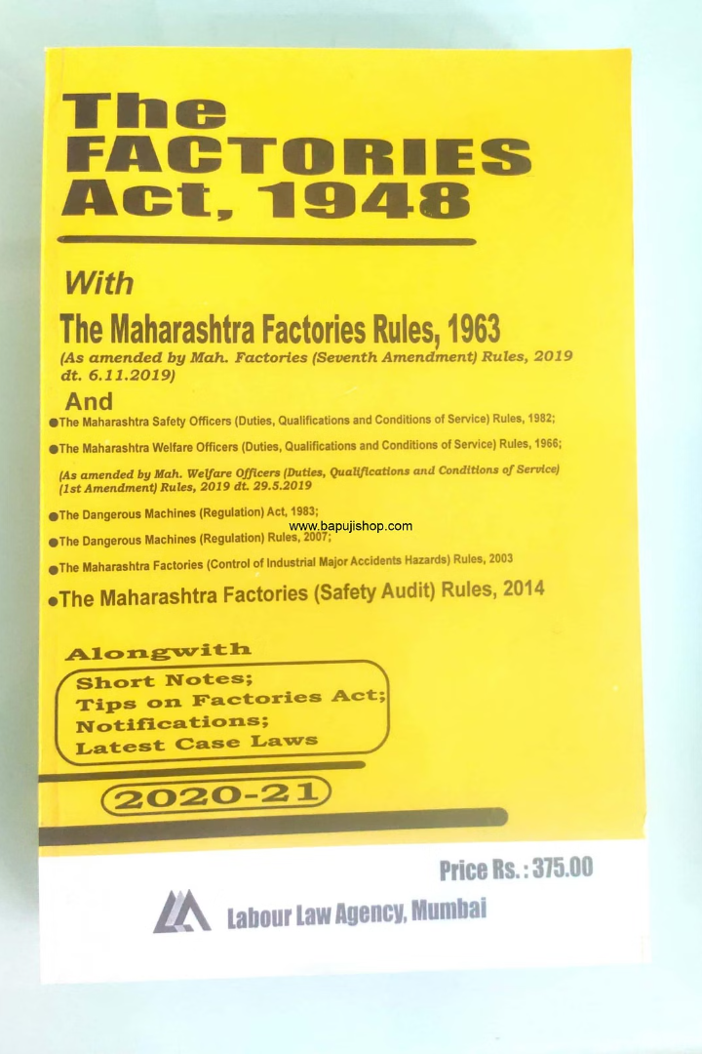
THE FACTORIES ACT, 1948
Chapter IV : Safety
Section 40 (B) Safety Officers

Slide 2
The Factories Act of 1948
The Factories Act of 1948, a landmark legislation in India, aims to ensure the welfare, health, and safety of workers employed in factories. Within this Act, Chapter IV specifically addresses safety measures, and Section 40(B) pertains to the appointment of safety officers.
Section 40(B) mandates that in factories employing a specified number of workers or carrying out certain hazardous processes, the factory management must appoint qualified safety officers. These safety officers play a crucial role in implementing and maintaining safety standards within the factory premises.

Slide 3
The key responsibilities of safety officers as outlined in Section 40(B) include:
Implementation of Safety Measures: Safety officers are tasked with implementing safety measures as prescribed by the Factory Act and other relevant regulations. This includes ensuring compliance with safety protocols, conducting regular safety inspections, and identifying potential hazards in the workplace.

Slide 4
Training and Education: Safety officers are responsible for organizing training programs and workshops to educate workers about safety procedures, emergency protocols, and the proper use of safety equipment. They also train workers to handle hazardous materials safely.

Slide 5
Investigation of Accidents: In the event of an accident or incident in the factory, safety officers are required to conduct thorough investigations to determine the causes and prevent recurrence. They must document accidents, analyze root causes, and recommend corrective actions to prevent similar incidents in the future.

Slide 6
Advisory Role: Safety officers serve as advisors to factory management on matters related to occupational safety and health. They provide expert guidance on safety regulations, best practices, and emerging safety trends to ensure continuous improvement in safety standards.

Slide 7
Emergency Preparedness: Safety officers are responsible for developing and implementing emergency response plans, including evacuation procedures, firefighting protocols, and first aid provisions. They conduct regular drills to ensure workers are prepared to respond effectively to emergencies.

Slide 8
Safety Committee: Safety officers often chair or participate in the factory safety committee, which comprises representatives from management and workers. They facilitate discussions on safety issues, review safety performance, and collaborate on initiatives to enhance workplace safety.

Slide 9
Compliance Monitoring: Safety officers monitor the factory's compliance with safety laws and regulations, as well as any specific directives issued by regulatory authorities. They maintain records related to safety inspections, training sessions, and accident investigations to demonstrate compliance during audits.

