Slide 1

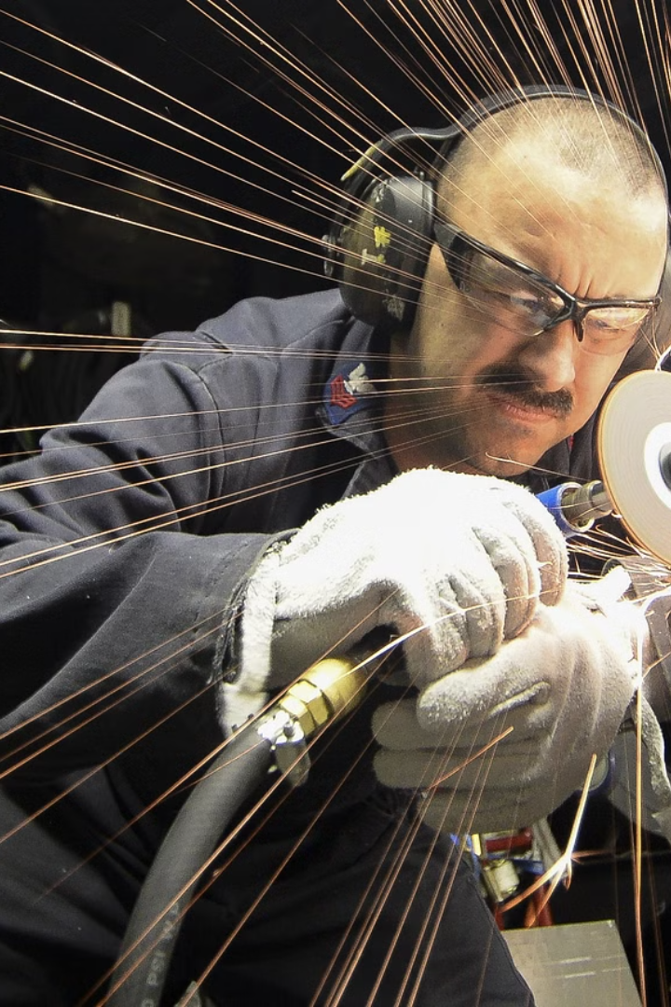
Top 10
Workplace Safety Violations
and
How to Avoid Them

Slide 2
"As a safety officer, it's crucial to be aware of these issues and take proactive measures to create a safer work environment."

Slide 3
Inadequate Personal Protective Equipment (PPE):
Ensure all employees have access to appropriate PPE.
Conduct regular assessments to confirm the adequacy of existing PPE.
Provide training on proper usage and maintenance of PPE.

Slide 4
Lack of Machine Guarding:
Implement machine guarding systems as per industry standards.
Conduct regular inspections to identify and address any issues promptly.
Train employees on the importance of machine guarding and safe operating procedures.

Slide 5
Poor Hazard Communication:
Establish clear and visible hazard communication systems.
Train employees on recognizing and understanding hazard symbols.
Encourage open communication channels for reporting hazards promptly.

Slide 6
Unsafe Lifting Practices:
Provide ergonomic training on proper lifting techniques.
Implement mechanical aids for heavy lifting tasks.
Encourage team lifting for heavier objects.

Slide 7
Electrical Hazards:
Regularly inspect and maintain electrical equipment.
Ensure compliance with electrical safety codes and standards.
Provide electrical safety training to employees.

Slide 8
Failure to Conduct Regular Safety Inspections:
Establish a routine safety inspection schedule.
Train designated personnel for effective safety inspections.
Address issues identified during inspections promptly.

Slide 9
Inadequate Training Programs:
Develop comprehensive safety training programs.
Regularly update training content to reflect changes in procedures or regulations.
Encourage employee participation and feedback in training sessions.

Slide 10
Improper Use of Tools and Equipment:
Provide proper training on tool and equipment usage.
Implement a system for inspecting and maintaining tools regularly.
Display clear guidelines on tool usage in the workplace.

Slide 11
Failure to Follow Lockout/Tagout Procedures:
Develop and implement a robust lockout/tagout program.
Train employees on lockout/tagout procedures.
Enforce strict adherence to lockout/tagout protocols during maintenance.

Slide 12
Ignoring Ergonomic Principles:
Design workstations with ergonomic principles in mind.
Provide ergonomic tools and equipment.
Conduct ergonomic assessments and address issues raised by employees.

