Slide 1

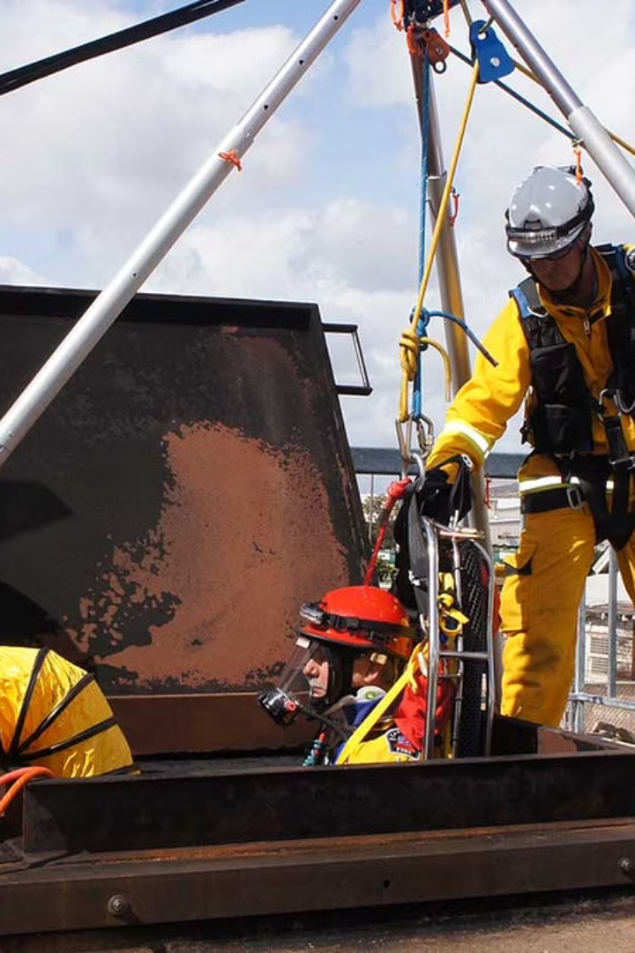
Confined Space Entry Procedure
Confined Space
Hazards and precaution
Procedure for Entering into Confined Space
Before Entry what make sure
Responsibilities of Supervisor
Responsibilities of confined space Enter Attendant
Responsibilities of Entrant

Slide 2
Confined Space
A confined space is an enclosed or partially enclosed area that:
Is large enough for a person to enter and perform work.
Has limited or restricted means for entry or exit.
Is not designed for continuous occupancy.

Slide 3
Hazards
Presence of toxic and flammables gases
Fire & Explosion
Poor ventilation
Poor illumination
Oxygen deficiency
Oxygen enrichment
Improper access or egress
Suffocation
Extreme Temperature

Slide 4
Precautions
Permit to Work
Confined space Entry Training
Gas Testing by Authorize Gas Tester
Hole watcher with entry exit log sheet
Regular communication with the entrants
Proper ventilation
Illumination
Proper access & Egress
ERP(Emergency Rescue Plan, all the workers who are doing works there
that should know the ERP)
ERE (Emergency Rescue Equipment should available there such as
Stretcher, Hereness, Crane, Tri-pod, scba, First aid kit etc.

Slide 5
Procedure for Entering into Confined Space
Permit to work
Tool box Meeting must be conduct for those are entering into confined space.
The attendant (stand by man) shall be assigned at the entrance to maintain communication with employees working inside to ensure their safety.
Safety attendant must be trained & authorized to use gas testing equipment
Entrants must wear body harness & if necessary a life line be attached to the harness to avoid entry -rescue
Maximum of 24 volts lighting should be used attached a GFCI OR ELCB.
Emergency rescue team should be available & its depending on situation
If an emergency occurs within the confined space, the stand by person must not enter it until rescue team arrived.
Barricade the area with warning sign board.

Slide 6
Before Entry into confined Space, You must to make sure
Permit to work.
Make sure that Gas test done
Isolate the space
Provide ventilation
Conduct Tool box Meeting (activity its hazard & precaution)
Entry into confined space.

Slide 7
Responsibilities of Supervisor
To ensure adequate protection is provided to the entry by verifications adequate LOTO & that all hazard are security isolated.
To support the attendant authority in controlling access to a confined space.
To assure that all personal involved are aware of the hazards asscociated with confined space.
To assure that rescue services are available prior to entry.

Slide 8
Responsibilities of confined space Entry (CSE) attendant
To monitor entrants during the job & during entry & exit to help ensure their safety.
To attendant may not abandon his post for any reason while personal are in the confined space unless relieved by another qualified attendant.
To monitor atmospheric conditions in the confined space prior to & during entry.
To control the access to the confined space.
To assign emergency assistance as needed.
To assess hazards in & around the confined space & take action on the same.
To keep records of confined space work such as GAS TEST RESULT, person entry.

Slide 9
Responsibilities of Entrant
Must assure that the confined space has been adequately ventilated. Isolated otherwise made safe for entry.
Must immediately exit the confined space if have any problem.
Must follow all the safety rules & procedure that apply to the job.
Must be familiar with the work to be performed & the procedures that apply to the job.
Must use the appropriate PPE whenever necessary.

