Slide 1
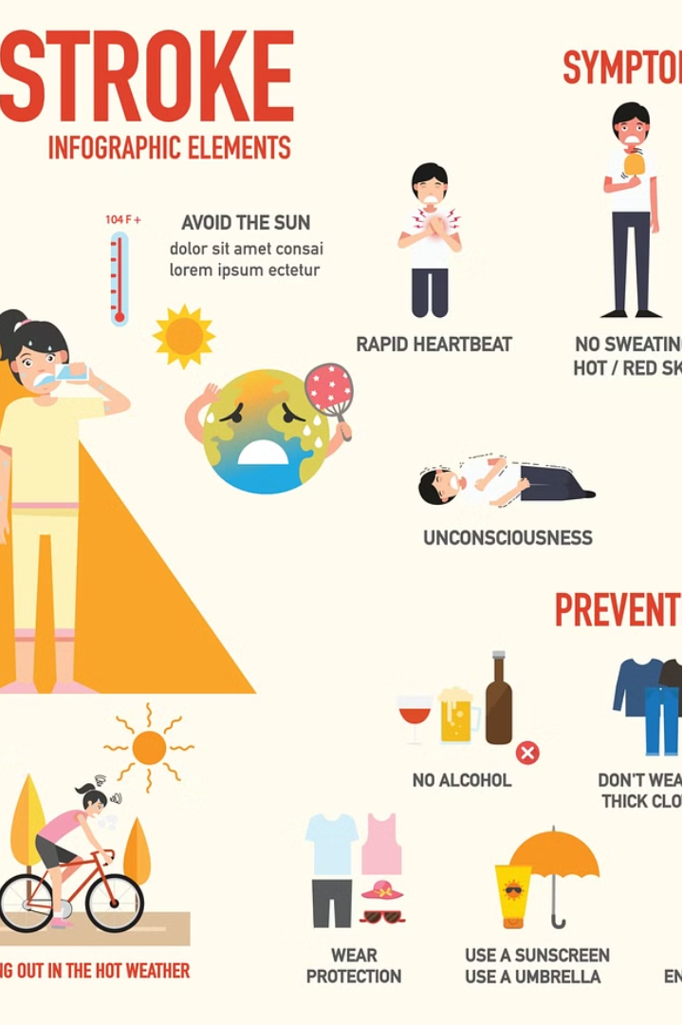

Toolbox Talk
Heat Exhaustion
Heat Stroke

Slide 2

Good morning everyone. Today, we're going to discuss a critical topic: heat-related illnesses, specifically heat exhaustion and heat stroke. As the weather warms up, it's essential to understand the signs, symptoms, and preventive measures to keep ourselves and our coworkers safe while working in hot environments.

Slide 3
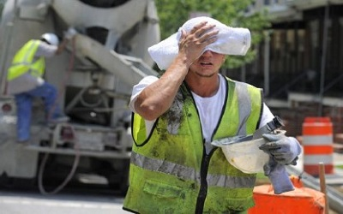
What is Heat Exhaustion?
Heat exhaustion occurs when the body overheats due to exposure to high temperatures and inadequate hydration. It's a serious condition that can lead to more severe heat-related illnesses if not addressed promptly.

Slide 4
Signs and Symptoms of Heat Exhaustion:
Profuse sweating
Weakness or fatigue
Dizziness or lightheadedness
Nausea or vomiting
Headache
Muscle cramps
Cool, clammy skin
Rapid heartbeat

Slide 5
Preventive Measures for Heat Exhaustion:
Stay hydrated by drinking plenty of water throughout the day.
Take frequent breaks in shaded or air-conditioned areas.
Wear lightweight, breathable clothing.
Avoid strenuous activity during the hottest parts of the day.
Monitor yourself and your coworkers for signs of heat exhaustion.

Slide 6

What is Heat Stroke?
Heat stroke is a severe form of heat-related illness that occurs when the body's temperature regulation fails. It's a medical emergency that requires immediate treatment to prevent serious complications, including organ damage or death.

Slide 7
Signs and Symptoms of Heat Stroke:
High body temperature (above 103°F or 39.4°C)
Hot, dry skin (lack of sweating)
Rapid pulse
Confusion or disorientation
Unconsciousness or seizures
Red, flushed skin
Nausea or vomiting
Headache

Slide 8
Preventive Measures for Heat Stroke:
Avoid working in extreme heat whenever possible.
If working outdoors, acclimatize yourself gradually to the heat.
Wear loose-fitting, lightweight clothing.
Take frequent breaks in shaded or air-conditioned areas.
Stay hydrated by drinking water regularly, even if you're not thirsty.
Be vigilant for signs of heat stroke in yourself and your coworkers.

Slide 9
Heat exhaustion and heat stroke are serious health concerns, especially during hot weather and when working in high-temperature environments. By recognizing the signs and symptoms and taking preventive measures, we can reduce the risk of these conditions and ensure a safer work environment for everyone. Remember, if you suspect someone is experiencing heat stroke, seek medical attention immediately. Stay safe and take care of yourselves. Thank you for your attention.

