Slide 1


How To Become an Aramco Approved
Safety Officer, Safety Engineer, Safety Supervisor, Safety Manager

Slide 2
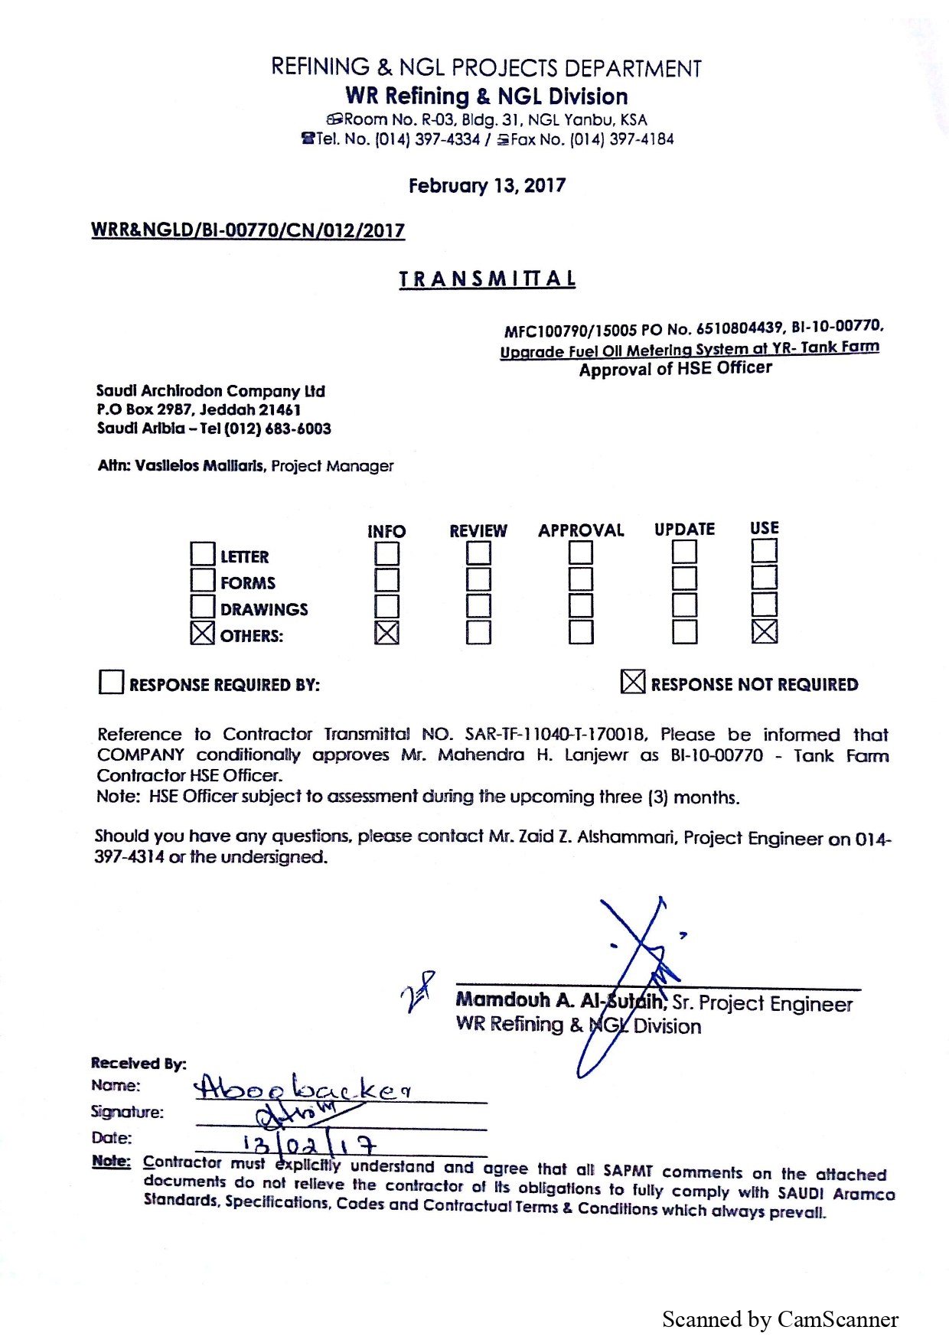

Slide 3
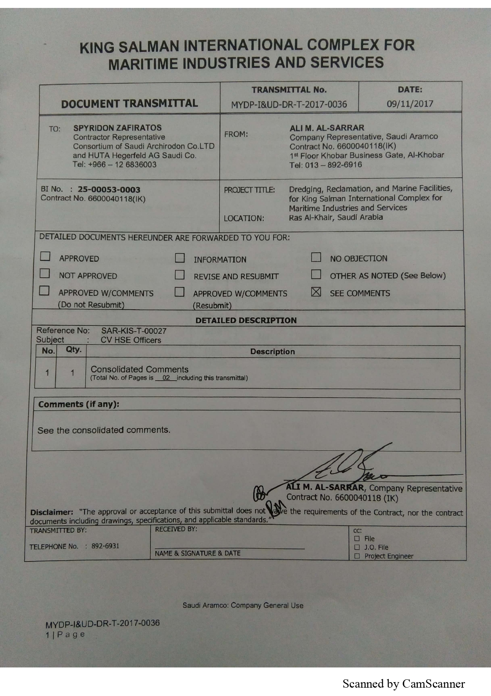
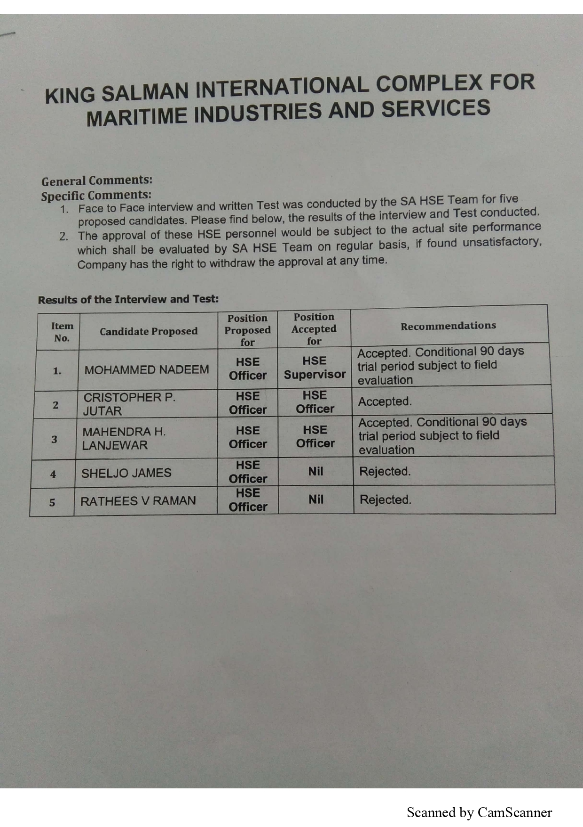

Slide 4
Saudi Aramco Approval

