Slide 1
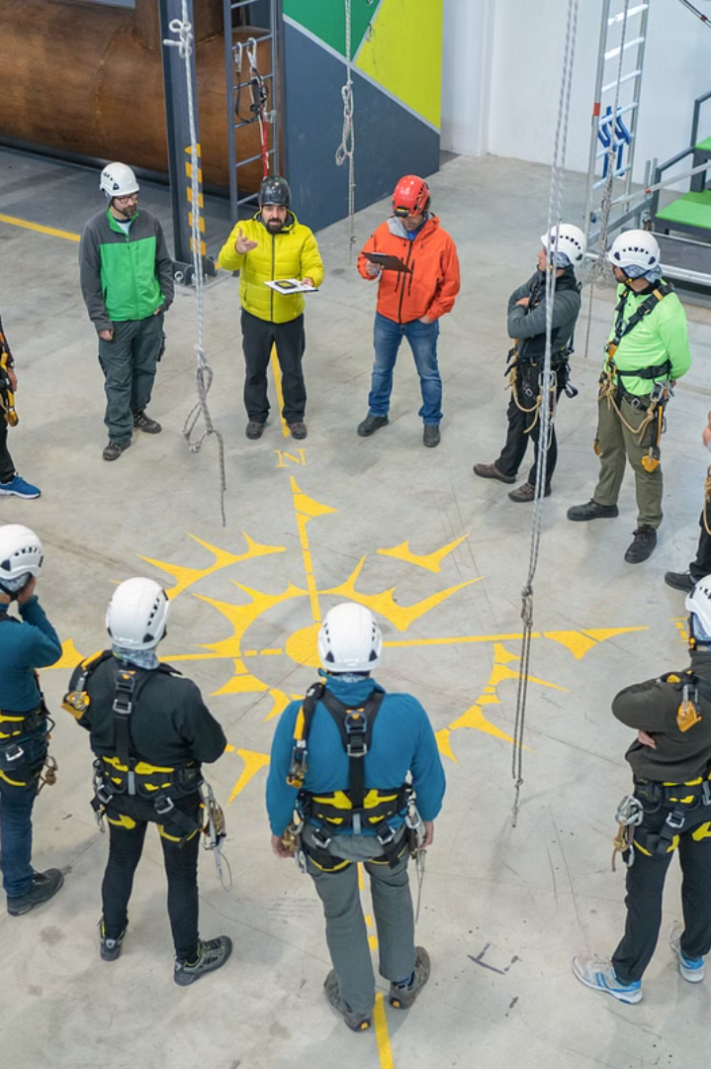

Job Safety Meeting

Slide 2
Job Safety Meeting
A job safety meeting, also known as a safety toolbox talk or safety briefing, is a crucial component of maintaining a safe working environment. These meetings bring together employees and supervisors to discuss various safety topics, hazards, procedures, and best practices relevant to the job at hand.

Slide 3
Purpose:
Share important safety information.
Foster open communication between management and workers.

Slide 4
Topics Covered:
During a job safety meeting, various topics may be covered depending on the nature of the work and the specific risks involved.
Proper use of personal protective equipment (PPE).
Hazard identification and reporting.
Emergency procedures.
Ergonomic practices.
Safe work practices for specific tasks or equipment.

Slide 5
Active Participation:
To make job safety meetings effective, it's essential to ensure active participation from all attendees. This can be achieved by
Encourage discussion.
Ask open-ended questions.
Provide real-life examples.
Use visual aids like diagrams or videos.

Slide 6
Frequency:
Conduct regularly, ideally before each shift.
Hold meetings whenever there are significant changes in work processes or conditions.

Slide 7
Benefits:
Mitigate risks.
Prevent accidents.
Protect the health and well-being of all employees.

Slide 8
How to conduct Job Safety Meeting:
Preparation: Choose a suitable time and location. Gather necessary materials like safety manuals, incident reports etc.
Agenda Setting: Outline topics to discuss, including recent incidents, hazards, safety procedures, and any updates or changes.
Attendance: Ensure all relevant personnel attend, including supervisors, employees, and safety officers.
Introduction: Start with a brief overview of the meeting's purpose and importance of safety.
Discussion: Address each agenda item systematically, encouraging participation and input from attendees.
Review of Incidents: Analyze recent incidents or near misses, identifying causes and discussing preventive measures.
Training: Provide relevant training on new safety procedures or equipment operation.
Q&A Session: Allow attendees to ask questions or raise concerns about safety issues.
Closure: Summarize key points, emphasize the importance of safety, and set expectations for the next meeting.
Documentation: Record meeting minutes.

