Slide 1
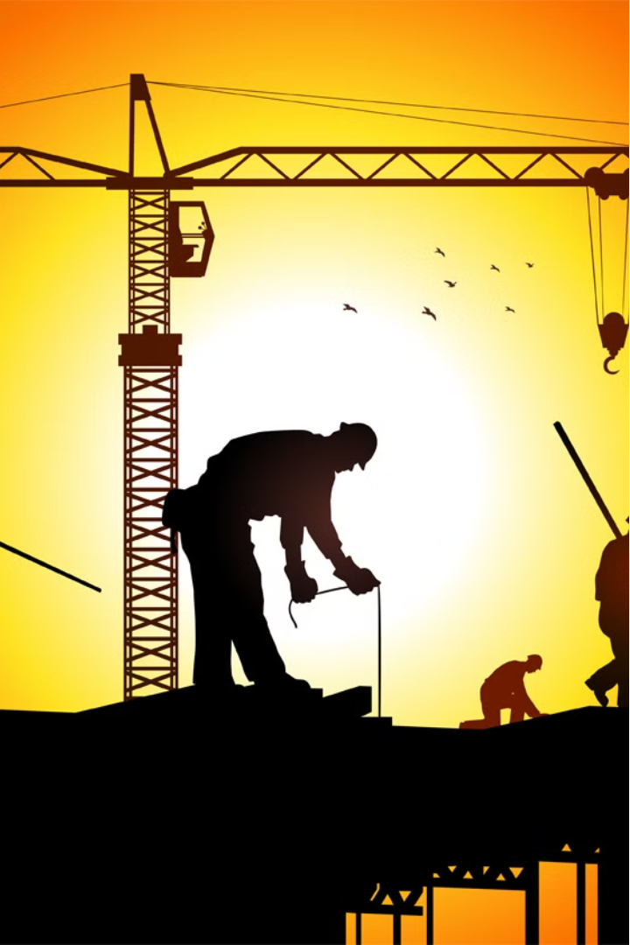

I am a safety officer. working on construction site.
I have to take safety precautions for Construction site in summer.
What should i do?

Slide 2
Hydration Stations: Set up hydration stations throughout the site with plenty of water, electrolyte drinks, and shaded rest areas. Encourage workers to drink water frequently, even if they don't feel thirsty.

Slide 3
Heat Awareness Training: Conduct regular training sessions on heat-related illnesses, their symptoms, and preventive measures. Ensure all workers are aware of the risks associated with working in high temperatures.

Slide 4
Adjust Work Schedule: Schedule strenuous tasks for cooler parts of the day, such as early morning or late afternoon. Minimize outdoor work during peak sun hours (typically between 12 and 3 p.m.).

Slide 5
Frequent Breaks: Implement a frequent break schedule to allow workers to rest in shaded or air-conditioned areas. Encourage them to take short breaks to cool down and hydrate regularly.

Slide 6
Monitoring Signs of Heat Illness: Train supervisors to recognize signs of heat-related illnesses such as heat exhaustion or heat stroke. Have a protocol in place for immediate medical attention if someone shows symptoms.

Slide 7
Ventilation and Cooling Measures: Utilize fans, misting systems, or portable air conditioning units to provide relief in enclosed or indoor work areas. Ensure proper ventilation in confined spaces to prevent heat buildup.

Slide 8
Lighter Workload: Consider reducing the workload or extending project timelines during extreme heat conditions to minimize the risk of heat-related incidents.

Slide 9
Regular Inspections: Conduct regular inspections of the site to identify potential hazards related to heat exposure, such as hot surfaces, inadequate ventilation, or insufficient shade.

Slide 10
Emergency Response Plan: Develop and communicate a comprehensive emergency response plan specific to heat-related incidents. Ensure all workers know whom to contact and what steps to take in case of an emergency.

Slide 11
Personal Protective Equipment (PPE): Provide and enforce the use of appropriate PPE for hot weather, such as lightweight, breathable clothing, wide-brimmed hats, sunglasses, and sunscreen with high SPF.

