Slide 1
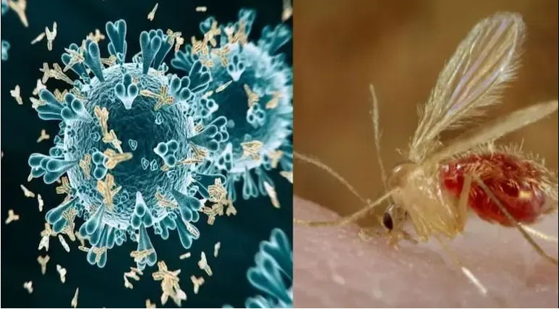
Chandipura Virus
All About Symptoms,
Who Is At Risk,
How It Spreads,
Preventive Measures

Slide 2
History
The Chandipura virus, discovered in 1965 in the town of Chandipura in Maharashtra, India
CHPV is named after the village where it was first identified.

Slide 3
How Chandipura Virus Spreads
The primary vector for Chandipura virus transmission is the sandfly.
Sandfly Bites: Infected sandflies transmit the virus through their bites. The virus enters the bloodstream and begins to replicate.

Slide 4
Who Is At Risk?
Chandipura virus primarily affects children, particularly those under 15 years of age.

Slide 5
Symptoms
High fever
Severe headache
Vomiting
Muscle and joint pain
As the infection progresses, more severe symptoms can develop, particularly affecting the central nervous system:
Altered mental status
Coma
Paralysis
In severe cases, it can be fatal if not treated promptly.

Slide 6
Treatment
There is no specific antiviral treatment for Chandipura virus infection.
Hospitalization: Severe cases require intensive care and monitoring.
Intravenous Fluids: To maintain hydration and electrolyte balance.
Antipyretics: To reduce fever.

Slide 7
Prevention
Preventing Chandipura virus infection largely involves controlling the sandfly population and minimizing human exposure to these vectors. Effective preventive measures include:
Insect Repellents: Using repellents on exposed skin and clothing to deter sandfly bites.
Protective Clothing: Wearing long sleeves and pants to reduce skin exposure.
Insecticide Spraying: Applying insecticides in and around living areas to reduce sandfly populations.
Bed Nets: Sleeping under insecticide-treated bed nets, especially in endemic areas.

