Slide 1
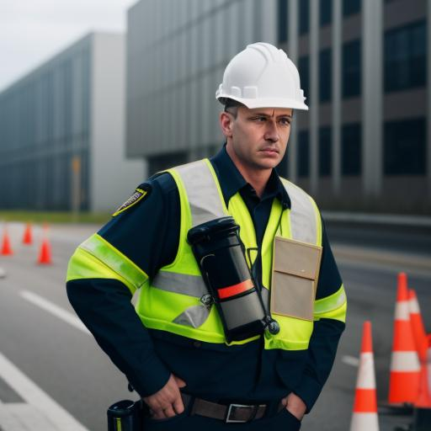
The Role of a Safety
Officer in
Emergency Situations

Slide 2

Safety Officer’s Role in a Construction Site Emergency
Imagine a scenario on a busy construction site where a gas leak is detected near the welding area. This situation is hazardous due to the high risk of explosion and fire. Let’s walk through how a safety officer would manage this emergency step-by-step.

Slide 3
1. Detection and Initial Response
The gas leak is detected by a worker who reports it to the safety officer immediately. As the safety officer, the first steps are:
Identifying the source of the leak and assessing the extent of the danger.
Alerting all workers in the vicinity through a loudspeaker or emergency alarm to stop all work and move to a safe distance from the leak.
Stopping all ignition sources such as welding equipment, machinery, and electrical devices to prevent any potential sparks or flames.

Slide 4
2. Evacuation and Containment
The safety officer quickly initiates an evacuation of the area:
Directing workers to the nearest safe exits and ensuring they move calmly toward the designated assembly point.
Shutting off gas valves and isolating the area where the leak occurred, if it is safe to do so.
Assisting workers in evacuating heavy machinery operators and ensuring all equipment is turned off as part of the site’s emergency procedures.

Slide 5
3. Communicating with Emergency Services
After ensuring all workers are at a safe distance, the safety officer:
Contacts local emergency services and reports the gas leak, providing details on the type of gas, location, and any potential ignition sources in the area.
Keeps the communication line open, coordinating with fire services and paramedics to provide them with the information they need to respond effectively.
Informs site management about the incident, updating them on the evacuation status and any immediate risks.

Slide 6
4. Assisting First Responders and Conducting Headcount
Once emergency services arrive, the safety officer:
Guides first responders to the location of the gas leak, informing them of the actions already taken, such as turning off gas valves and isolating the area.
Ensures all workers are accounted for at the assembly point, performing a headcount and confirming everyone’s safety.
Checks for injuries or exposure symptoms among workers, providing first aid if needed and relaying any concerns to the paramedics.

Slide 7
5. Conducting Post-Incident Review
After the emergency is resolved and the site is declared safe, the safety officer organizes a review of the incident:
Gathering feedback from workers on the evacuation process, noting any confusion or obstacles they encountered.
Updating emergency plans to include lessons learned, such as adjusting evacuation routes, improving gas detection systems, or enhancing communication procedures.
Organizing a follow-up drill to ensure all workers understand any new safety procedures implemented as a result of this incident.

