Slide 1

Hazard Hierarchy of Control
Examples

Slide 2
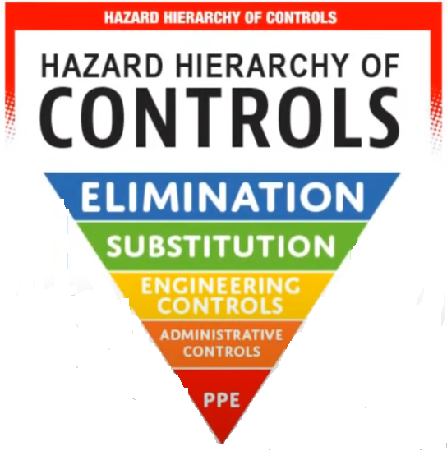
Hazard Hierarchy of Control
The Hazard Hierarchy of Control is a systematic approach used in workplace safety to eliminate or reduce risks. It prioritizes hazard control methods from the most effective to the least effective.

Slide 3
1. Elimination (Most Effective)
Definition: Completely removing the hazard from the workplace.
Example: Using automated machinery to eliminate the need for manual handling of hazardous substances.
Elimination is the most effective control method as it removes the hazard entirely, leaving no residual risk.

Slide 4
2. Substitution
Definition: Replacing a hazardous material or process with a less dangerous one.
Example: Switching from a toxic solvent to a non-toxic alternative in cleaning operations.
Substitution minimizes the risk but still requires careful evaluation to ensure the replacement does not introduce new hazards.

Slide 5
3. Engineering Controls
Definition: Isolating workers from the hazard through physical changes to the workplace or equipment.
Example: Installing ventilation systems to remove harmful fumes or enclosing noisy machinery.
These controls aim to create a safer environment without relying on worker behavior.

Slide 6
4. Administrative Controls
Definition: Changing work procedures or policies to reduce exposure to hazards.
Example: Rotating shifts to limit individual exposure time to hazardous environments or conducting safety training sessions.
Administrative controls are less effective because they rely on consistent adherence by employees.

Slide 7
5. Personal Protective Equipment (PPE) (Least Effective)
Definition: Providing workers with gear to protect against hazards.
Example: Gloves, safety goggles, helmets, and respirators.
PPE should be considered a last resort because it does not eliminate the hazard and requires proper use and maintenance.

Slide 8
The Pyramid of Control
Level | Examples | Effectiveness
1. Elimination | Remove a dangerous machine | High
2. Substitution | Replace lead-based paint | High
3. Engineering | Guardrails on walkways | Moderate
4. Administrative | Training and procedures | Low
5. PPE | Hard hats and gloves | Lowest

