Slide 1
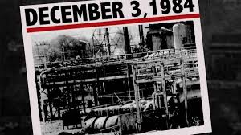
How Did it Occur, What Were the Causes,
Who Was Affected, What Action Was Taken, and
Who Was Responsible?
Bhopal Gas Tragedy

Slide 2
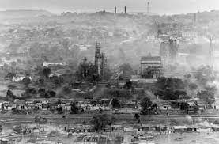
Bhopal Gas Tragedy
The Bhopal Gas Tragedy is one of the world's worst industrial disasters, which occurred in Bhopal, India, on the night of December 3, 1984. It involved the release of toxic gas from the Union Carbide India Limited (UCIL) pesticide plant, resulting in significant loss of life, widespread environmental damage, and long-term health effects.

Slide 3
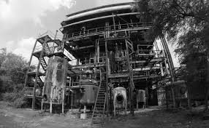
How Did it Occur?
The tragedy occurred due to a chemical leak of methyl isocyanate (MIC) gas, a highly toxic substance used in pesticide production. The leak happened after a series of failures in safety systems and human error. On the night of the disaster, water entered a MIC storage tank, causing a chemical reaction that led to the release of a deadly gas cloud. The gas spread rapidly across the surrounding areas, affecting thousands of people.

Slide 4
What Were the Causes?
Several factors contributed to the Bhopal disaster:
Inadequate Safety Systems: The plant's safety systems were poorly maintained and lacked adequate safety measures.
Poor Management: Cost-cutting measures resulted in the reduction of safety personnel and inadequate training.
Technical Failures: The refrigeration system, which was supposed to keep the MIC tank at a safe temperature, was not functioning correctly.
Human Error: A plant worker inadvertently added water to the MIC tank, triggering the reaction.
Lack of Safety Culture: There was a general disregard for safety protocols and regulatory oversight in the plant's operations.

Slide 5
Who Was Affected?
The disaster affected an estimated 500,000 people in and around Bhopal. Immediate deaths were reported in the thousands, with estimates ranging from 3,000 to 8,000 people in the first few days. Thousands more suffered from long-term health effects such as respiratory issues, eye problems, birth defects, and cancer. The disaster caused severe environmental damage, with contamination of soil and water sources in the surrounding areas.

Slide 6
What Action Was Taken?
Emergency Response and Medical Assistance: The Indian government, along with various local organizations, responded by providing immediate medical aid and setting up relief camps. However, the response was poorly coordinated, and many victims did not receive adequate treatment in time.
Legal Actions and Compensation: In 1989, Union Carbide reached a settlement with the Indian government, agreeing to pay $470 million in compensation. This amount, however, was widely criticized as grossly insufficient given the scale of the disaster. Many victims and their families continued to demand justice, but legal battles dragged on for decades.
Environmental Cleanup:
Regulatory Changes: The government introduced stricter regulations regarding the handling of hazardous chemicals, and the Disaster Management Act of 2005 was enacted to better prepare the country for industrial accidents.

Slide 7
Who Was Responsible?
The responsibility for the Bhopal Gas Tragedy is a subject of significant debate:
Union Carbide: The company, especially its parent company, Union Carbide Corporation, was widely blamed for the disaster due to its failure to ensure the plant's safety and proper maintenance. The plant's design was flawed, and safety measures were neglected.
Government of India: The Indian government was criticized for not enforcing stricter safety regulations and for failing to adequately monitor the operations of industrial plants.
Warren Anderson: The CEO of Union Carbide at the time, Warren Anderson, was charged with criminal negligence, but he never faced trial in India. He was arrested in India after the disaster but was released on bail and never returned for trial.
Management and Workers: Some also pointed to the lack of adequate training and the decision to cut safety measures for cost-saving as contributing factors.

