Slide 1
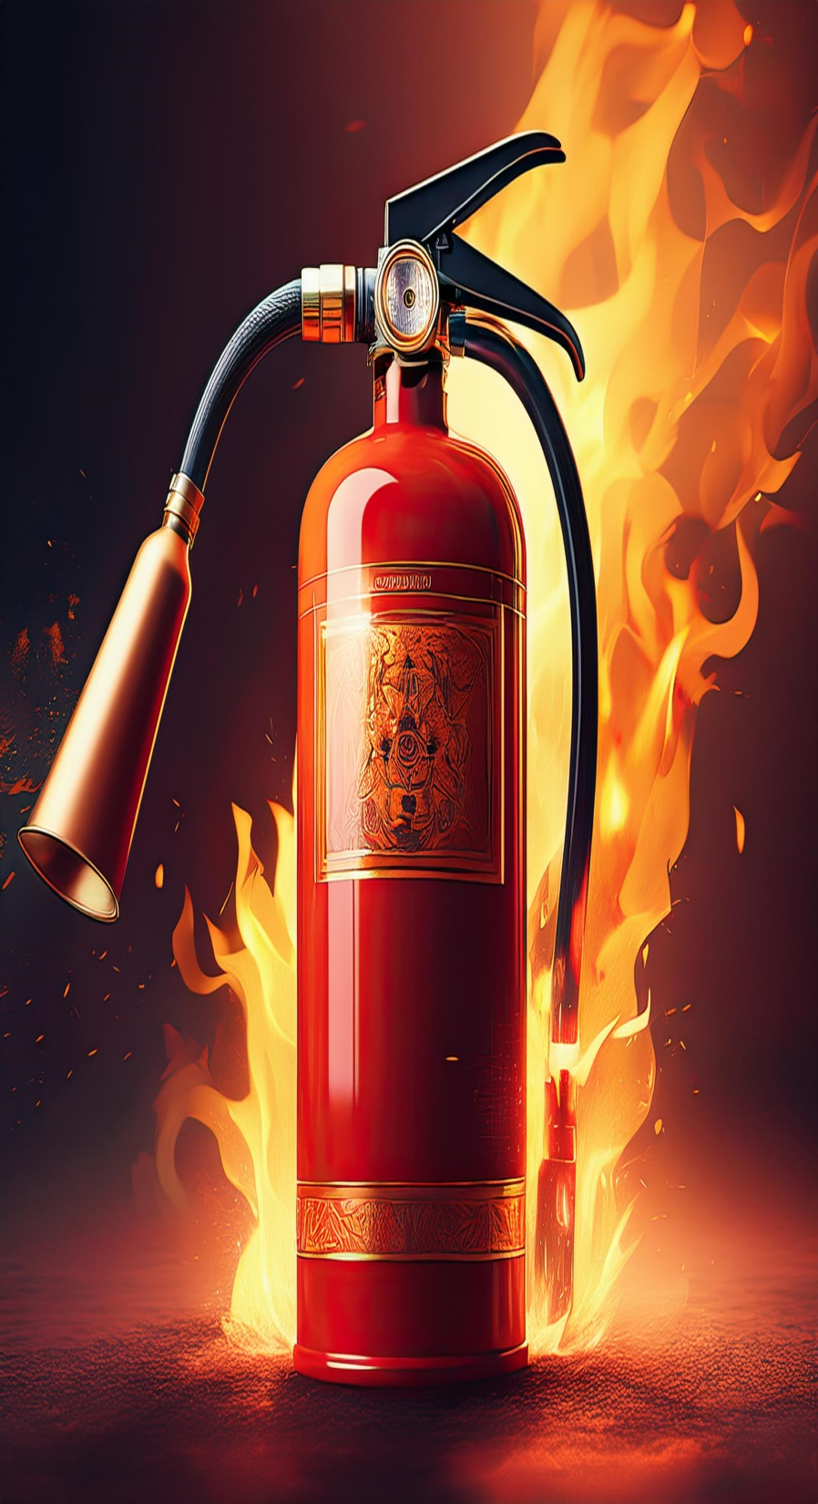
How Does a Fire Extinguisher Work

Slide 2
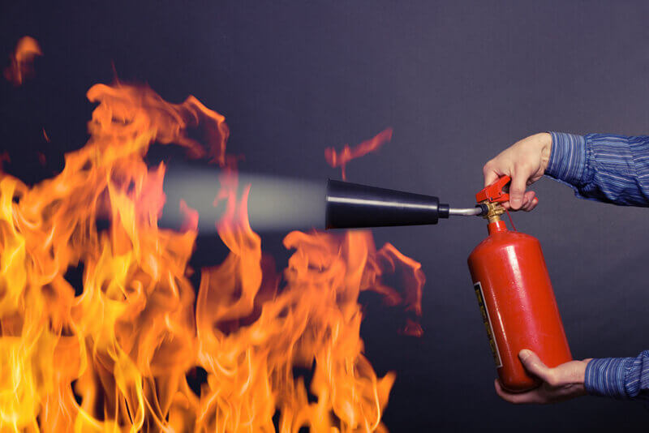
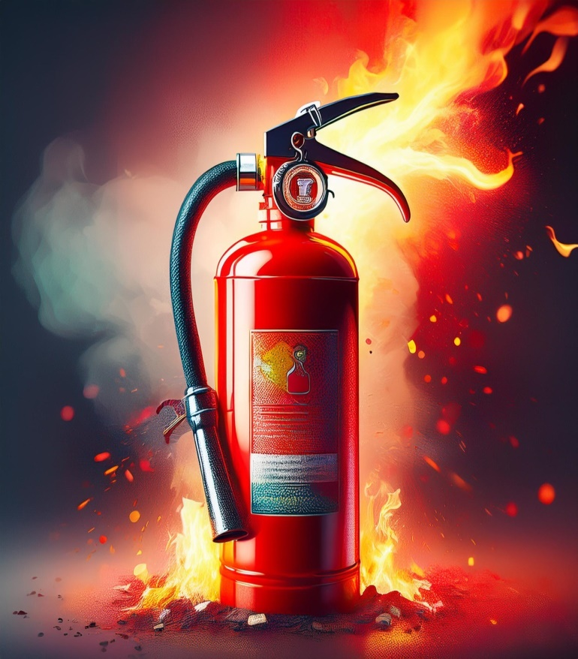
How Does a Fire Extinguisher Work?
Fire extinguishers rely on pressurized gas to expel an extinguishing agent. When the handle is squeezed, the agent is forced out through a nozzle, targeting the fire and disrupting its chemical reaction.

Slide 3
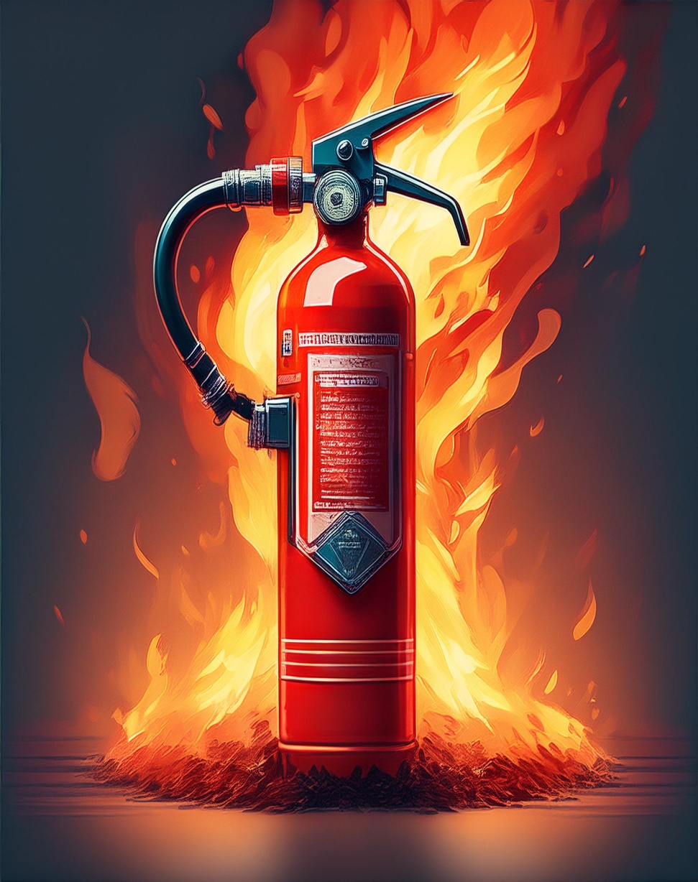
Components of a Fire Extinguisher
Cylinder: Holds the extinguishing agent and pressurized gas.
Handle and Lever: Activate the extinguisher.
Pressure Gauge: Indicates readiness.
Nozzle or Hose: Directs the agent to the fire.
Safety Pin: Prevents accidental discharge.

Slide 4
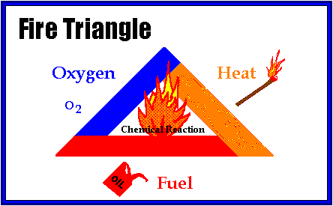
A fire extinguisher works by
interrupting the fire's combustion process.
Fires require three elements to sustain themselves: heat, fuel, and oxygen (known as the fire triangle).
A fire extinguisher disrupts one or more of these elements, effectively putting out the fire.
Here's how it works based on the type of extinguisher:

Slide 5
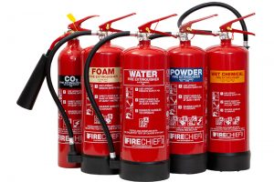
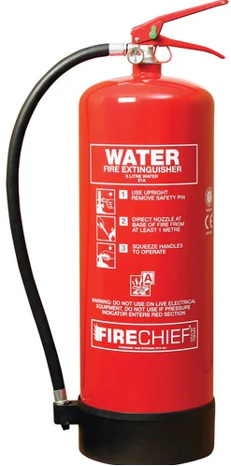
1. Water-Based Extinguishers
Mechanism: They cool the heat of the fire, removing one side of the fire triangle.
Use: Effective for fires involving solid combustibles like wood, paper, or cloth.
Not for: Electrical or flammable liquid fires.

Slide 6
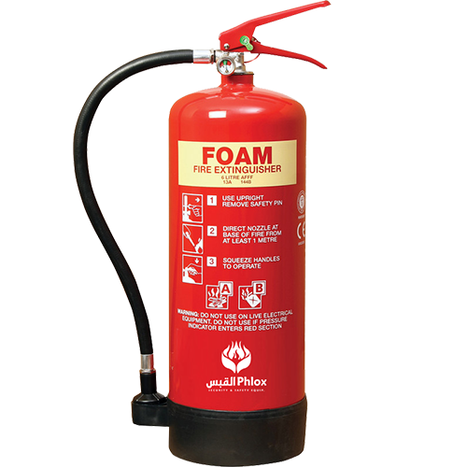
2. Foam Extinguishers
Mechanism: Foam blankets the fuel surface, cutting off oxygen and cooling the fire.
Use: Ideal for flammable liquids and solid fires.
Not for: Electrical fires.

Slide 7
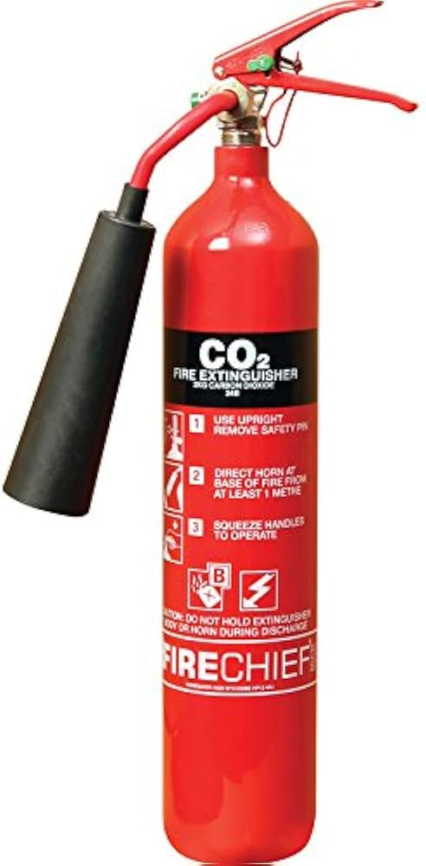
3. Carbon Dioxide (CO₂) Extinguishers
Mechanism: CO₂ gas replaces oxygen around the fire and cools it by rapid expansion.
Use: Suitable for electrical fires and flammable liquids.
Not for: Solid combustibles
like paper or wood.

Slide 8

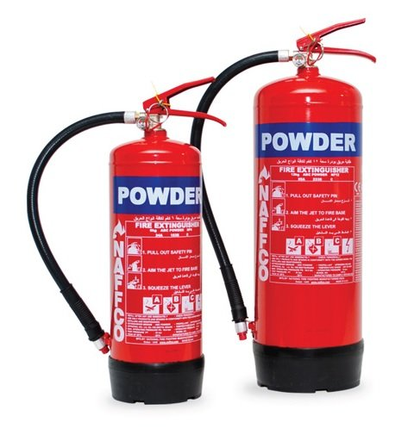
4. Dry Powder Extinguishers
Mechanism: The powder forms a barrier on the fuel surface, cutting off oxygen. It also disrupts the chemical reaction in the fire.
Use: Effective on most types of fires,
including gas and electrical fires.
Not for: Fires in enclosed spaces
(residue may harm people
or equipment).

Slide 9
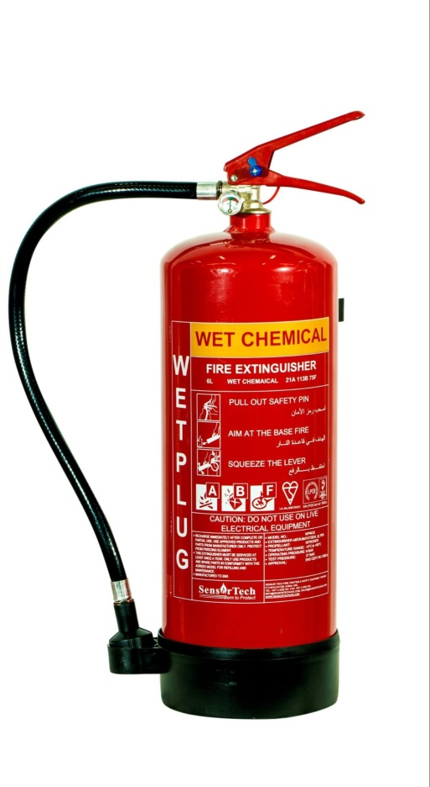
5. Wet Chemical Extinguishers
Mechanism: A fine mist cools the flames, and the chemical reacts with burning oils or fats to create a soapy layer that smothers the fire.
Use: Best for cooking oil and fat fires.

Slide 10
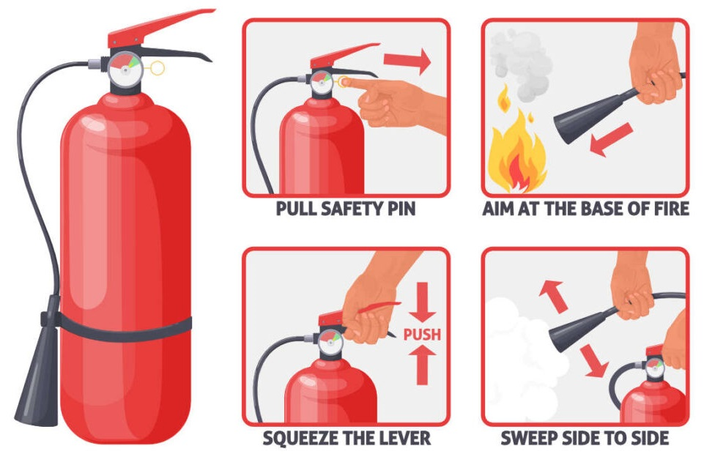
General Steps to Use
Pull the safety pin to unlock the extinguisher.
Aim the nozzle at the base of the fire.
Squeeze the handle to release the extinguishing agent.
Sweep the nozzle side to side to cover the entire area of the fire.

