Slide 1
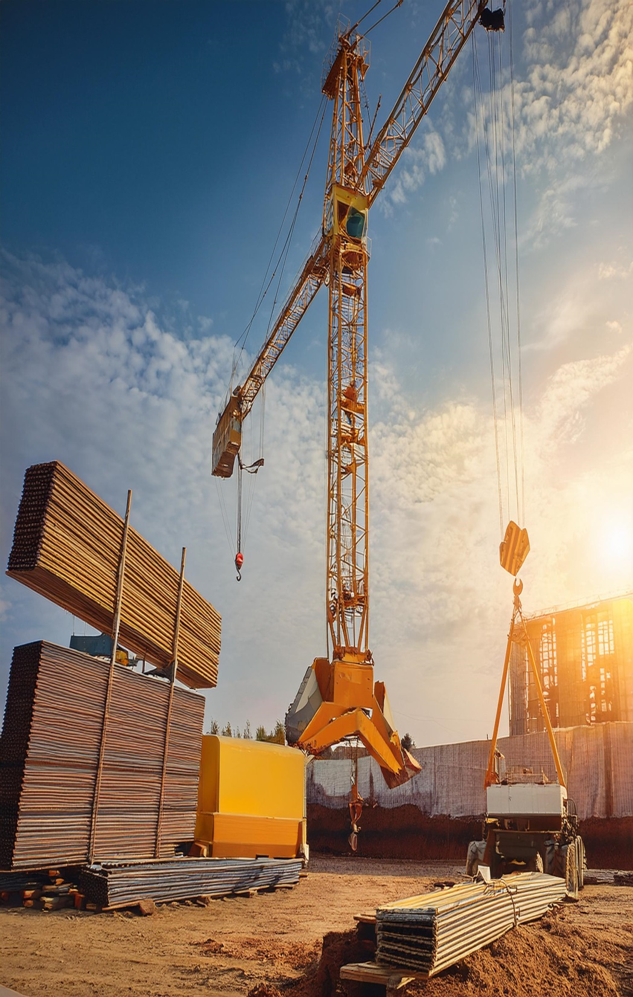
Tower Crane
Hazards and Control Measures

Slide 2
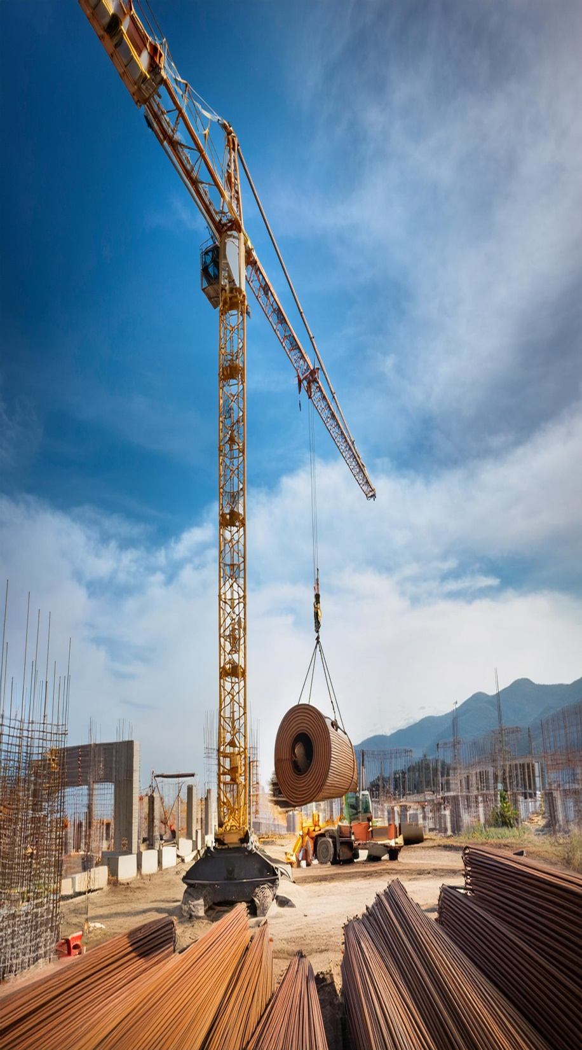
A tower crane is a machine used to lift and move heavy materials during construction, especially for high-rise buildings.
Fixed to the ground on a concrete slab (and sometimes attached to the sides of structures)

Slide 3
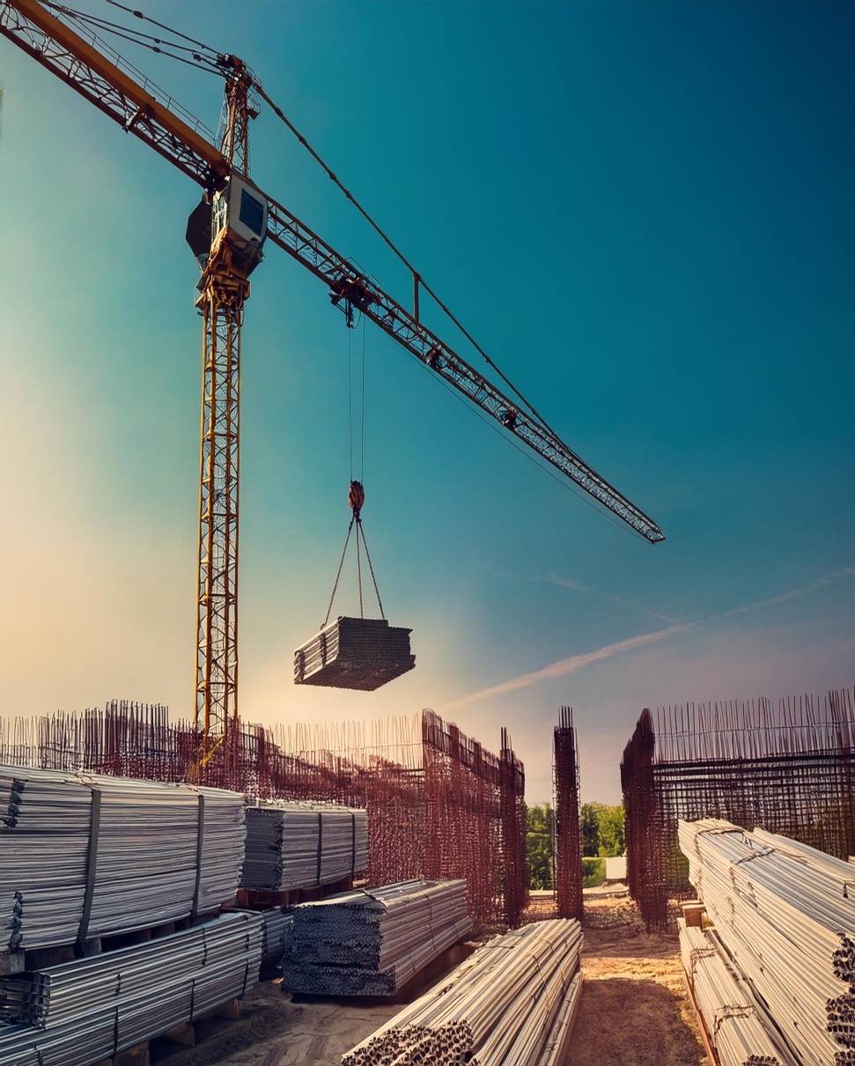
Common Hazards Associated with Tower Cranes
a. Crane Collapse
Causes: Overloading, structural failure, or poor ground conditions.
Risks: Injuries, fatalities, and property damage.

Slide 4
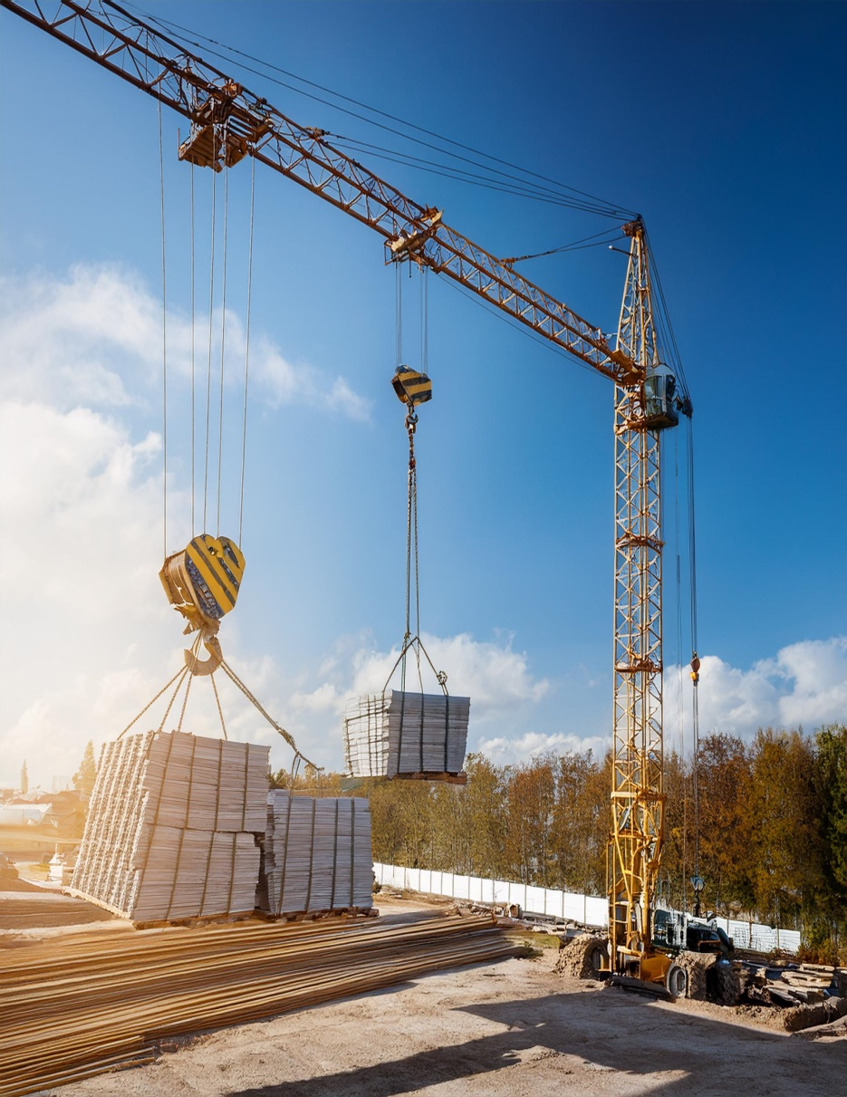
Common Hazards Associated with Tower Cranes
b. Falling Loads
Causes: Improper rigging, load overcapacity, or equipment failure.
Risks: Severe injury or death to workers and bystanders.

Slide 5
Common Hazards Associated with Tower Cranes
c. Electrical Hazards
Causes: Contact with overhead power lines or improper electrical grounding.
Risks: Electrocution and fires.

Slide 6
Common Hazards Associated with Tower Cranes
d. Weather-related Hazards
Causes: High winds, rain, or lightning.
Risks: Instability of the crane, reduced visibility, and slippery surfaces.

Slide 7
Common Hazards Associated with Tower Cranes
e. Operator Error
Causes: Inadequate training, fatigue, or distractions.
Risks: Unsafe movements, collisions, and accidents.

Slide 8
Common Hazards Associated with Tower Cranes
f. Proximity Hazards
Causes: Operating near buildings, other cranes, or workers.
Risks: Collisions, entrapment, and injuries.

Slide 9
Control Measures for Tower Crane Hazards
a. Proper Installation and Inspection
Ensure cranes are installed on stable ground with appropriate foundations.
Conduct regular inspections to identify wear and tear or defects.
Follow manufacturer guidelines for installation and maintenance.

Slide 10
Control Measures for Tower Crane Hazards
b. Load Management
Use cranes within their specified load limits.
Ensure loads are properly rigged using suitable lifting equipment.
Train workers in proper rigging techniques.

Slide 11
Control Measures for Tower Crane Hazards
c. Electrical Safety Measures
Maintain a safe distance from overhead power lines (at least 10 feet).
Use ground fault circuit interrupters (GFCIs) where necessary.
Train operators and workers in electrical hazard awareness.

Slide 12
Control Measures for Tower Crane Hazards
d. Weather Precautions
Monitor weather forecasts and halt operations during adverse conditions.
Lower the jib and secure the crane during high winds.
Implement non-slip mats or surfaces on walkways and platforms.

Slide 13
Control Measures for Tower Crane Hazards
e. Operator Training and Competency
Hire certified and experienced operators.
Conduct periodic refresher training programs.
Establish clear communication protocols (e.g., radios or hand signals).

Slide 14
Control Measures for Tower Crane Hazards
f. Safe Site Layout and Planning
Establish exclusion zones to keep unauthorized personnel away.
Use spotters to guide operations near obstacles or crowded areas.
Coordinate operations when multiple cranes are in use to avoid collisions.

Slide 15
Control Measures for Tower Crane Hazards
g. Emergency Preparedness
Develop and communicate an emergency response plan.
Provide workers with training on crane emergency procedures.
Install warning alarms and lights to alert nearby workers of hazards.

