Slide 1

Types of
Tower Cranes

Slide 2
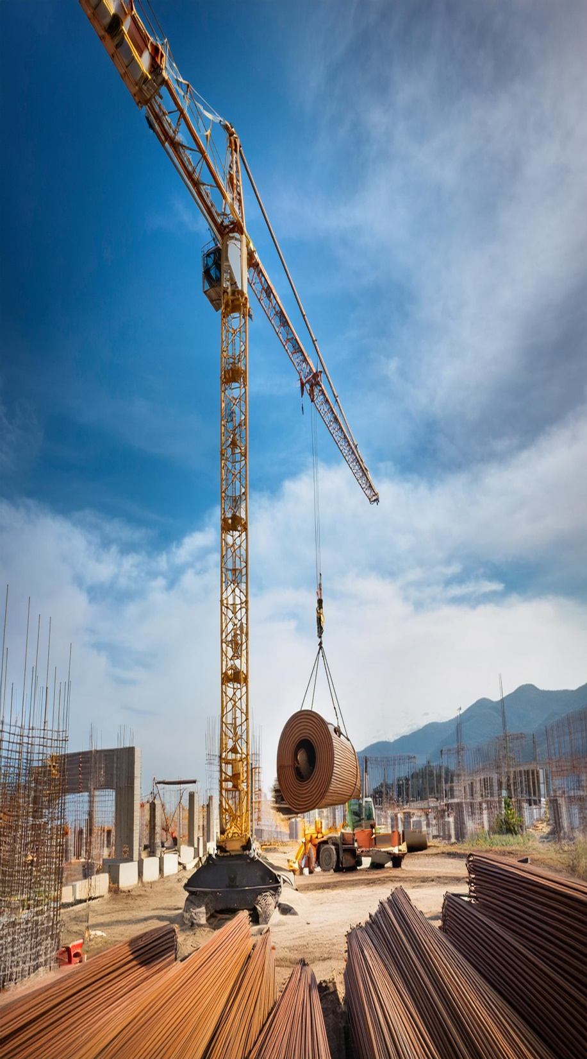
A tower crane is a machine used to lift and move heavy materials during construction, especially for high-rise buildings.

Slide 3

1. Fixed Tower Cranes
Fixed tower cranes are the most common type of tower crane. They are stationary, fixed to a concrete foundation, and cannot be moved during the project. Their large size and strong lifting capacity make them ideal for construction sites with large-scale projects.

Slide 4
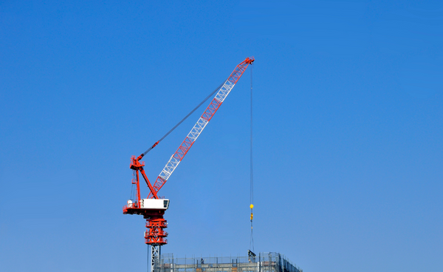
2. Luffing Jib Tower Cranes
Luffing jib cranes feature a jib (the horizontal arm) that can be raised or lowered, allowing the crane to adjust its lifting angle. This type of crane is especially useful in urban construction sites with limited space because it can operate in confined areas without swinging its boom across the site.

Slide 5
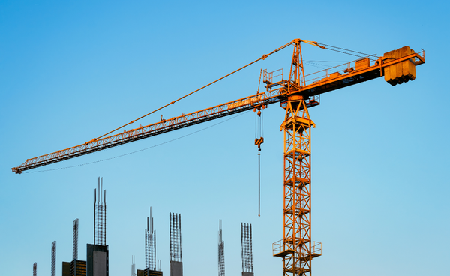
3. Hammerhead Cranes
Hammerhead cranes are a type of fixed tower crane with a horizontal jib that rotates around the mast. The shape of the jib resembles a hammerhead, giving the crane its name. These cranes are often used for large construction projects, including the construction of bridges, airports, and large buildings.

Slide 6
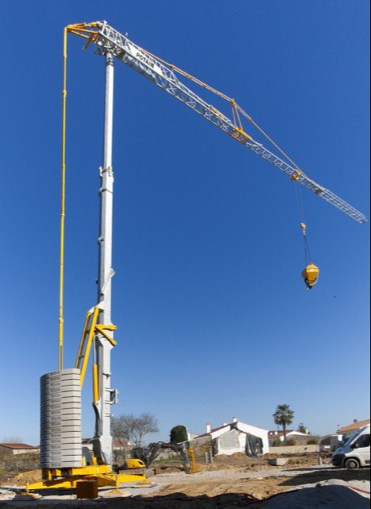
4. Self-Erecting Cranes
Self-erecting cranes are smaller tower cranes that can be assembled and disassembled by themselves. These cranes are highly mobile, often used for projects in smaller areas or where the crane needs to be relocated frequently. They are typically used for residential or low-rise construction.

Slide 7
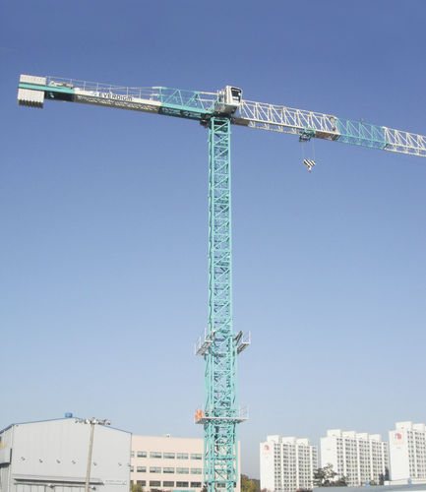
5. Topless Tower Cranes
Topless tower cranes have a design without a traditional "top" section that protrudes above the mast. These cranes have a more compact design, offering better visibility and easier access to surrounding areas. They are commonly used on construction sites where space is limited or multiple cranes are required in close proximity.

Slide 8
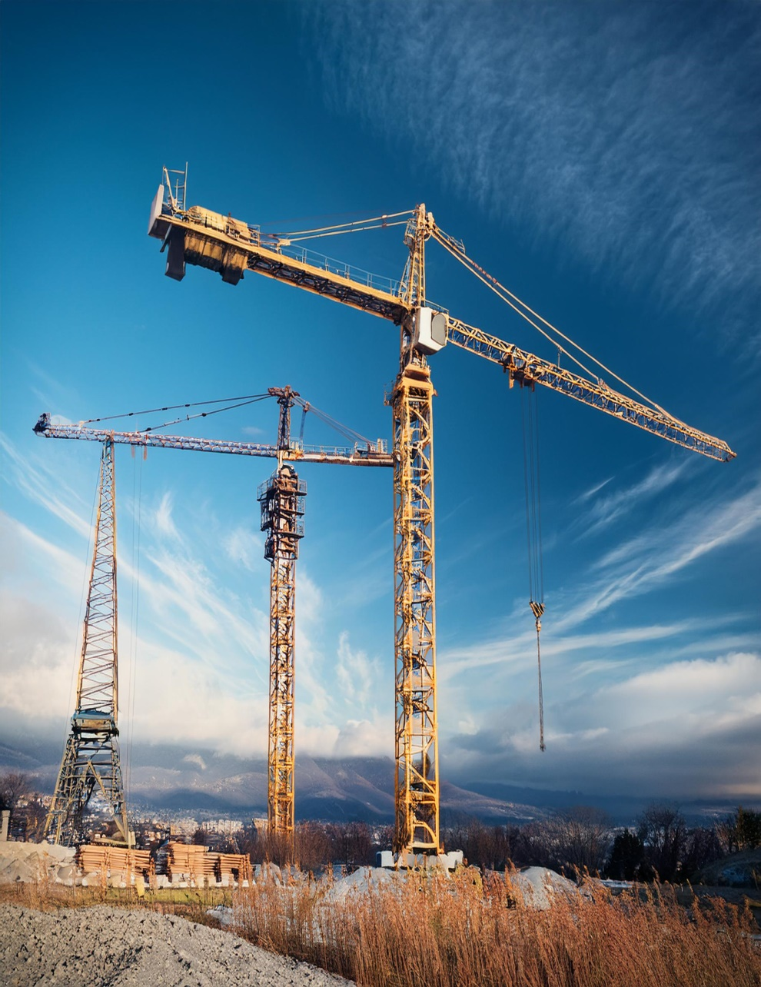
6. Slewing Jib Tower Cranes
Slewing jib tower cranes have a fixed vertical mast with a jib that can rotate around the mast. They are designed for lifting and moving loads in a circular area around the base of the crane. Slewing cranes are often used for projects where a large area needs to be covered, such as in the construction of industrial plants or large warehouses.

Slide 9
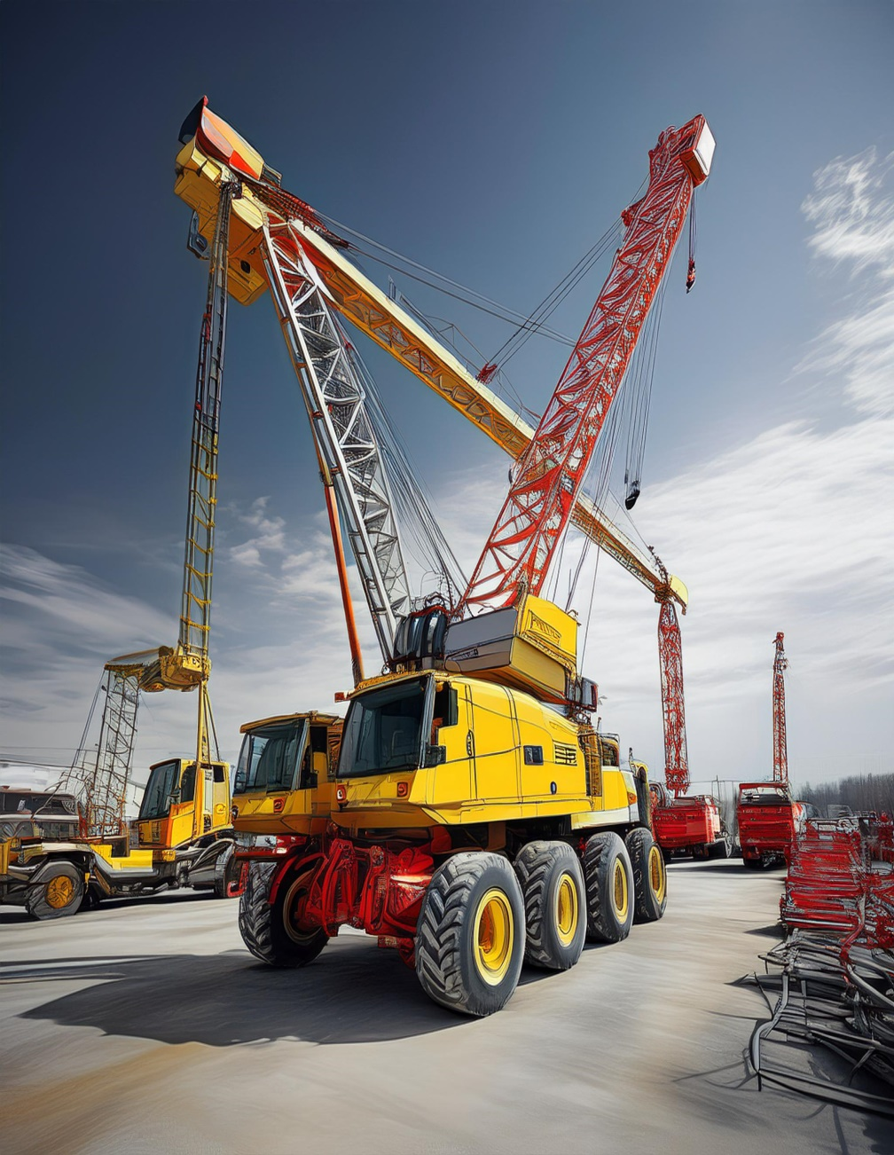
7. Mobile Tower Cranes
Mobile tower cranes are a hybrid between a tower crane and a mobile crane. These cranes have the ability to move on wheels or tracks, making them ideal for construction sites that require cranes to be repositioned frequently. While they can offer the benefits of a tower crane, their mobility provides added flexibility for changing job sites.

