Slide 1
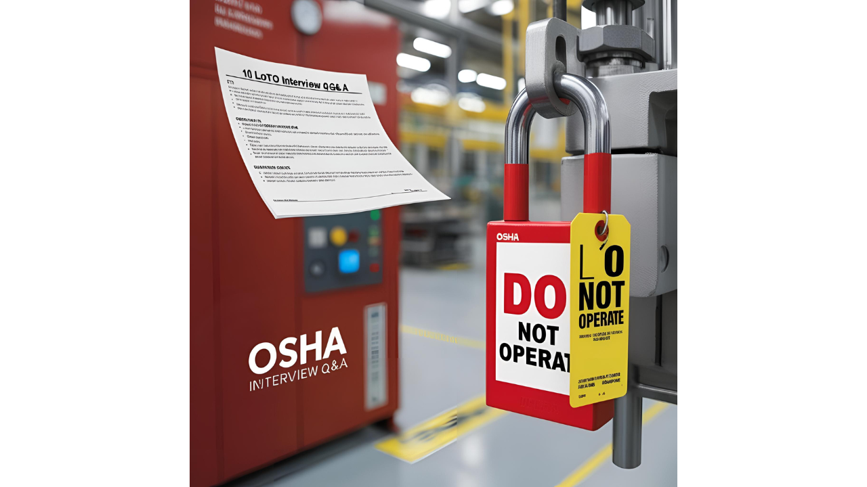
10 Lockout/Tagout (LOTO) Interview Questions & Answers

Slide 2

10 Lockout/Tagout – LOTO Interview Questions & Answers
5 HAZOP Interview Questions for Process Safety Engineers
5 Safety Interview Mistakes to Avoid (From Real Hiring Managers)
10 Emergency Preparedness Interview Questions (With Action Plans)
5 Safety Scenario Questions & How to Answer Them
10 Tricky Behavioral Safety Interview Questions (+ Sample Answers)
10 Risk Assessment Interview Questions (+ Matrix Examples)
10 One Minute Safety Interview Questions (Quick Answers)
Onshore Safety Officer vs Offshore Safety Officer: A Detailed Comparison
Oil & Gas Industry HSE Challenges and Solutions
Oil & Gas Safety Interview Questions & Answers (With Examples)
15 NEBOSH Interview Questions & Answers for Safety Officers
15 Electrical Safety Interview Questions Every Technician Must Know
Check Description
www.hsestudyguide.com

Slide 3
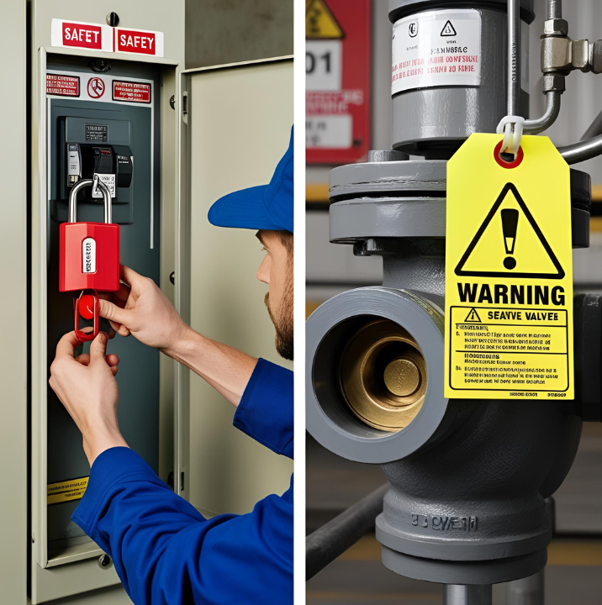
1. What is Lockout/Tagout (LOTO)?
LOTO is a safety procedure that ensures machines or equipment are properly shut off and cannot be restarted before maintenance or servicing is completed. Lockout involves using physical locks to isolate energy sources, while Tagout uses tags to warn employees not to operate the equipment.

Slide 4
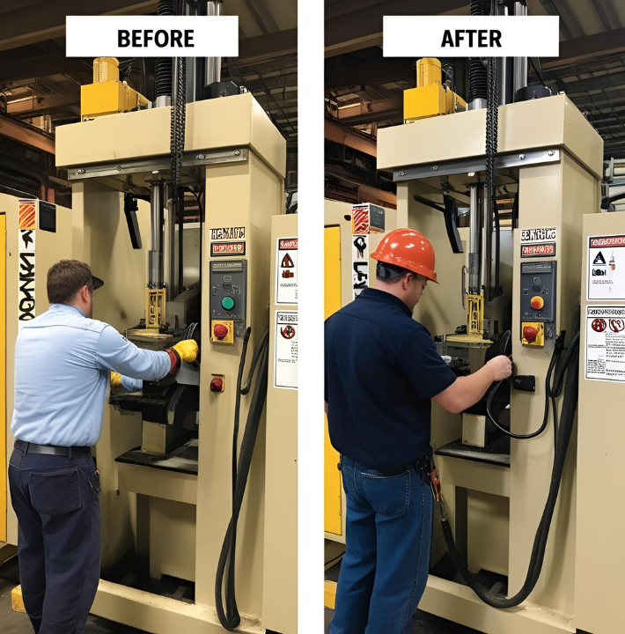
2. Why is LOTO important in the workplace?
LOTO prevents accidental machine startups or energy releases, which can cause severe injuries or fatalities. Compliance with OSHA’s 29 CFR 1910.147 standard helps protect workers from electrical, mechanical, hydraulic, and other hazardous energy sources.

Slide 5
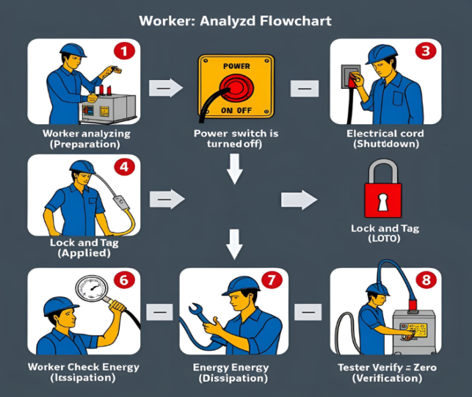
3. What are the key steps in a LOTO procedure?
The six key steps are:
Preparation – Identify energy sources and shutdown procedures.
Shutdown – Turn off the equipment properly.
Isolation – Disconnect all energy sources (electrical, pneumatic, hydraulic).
Lockout/Tagout – Apply locks and tags to energy isolation points.
Energy Dissipation – Release stored energy (e.g., capacitors, springs).
Verification – Test to ensure the equipment is de-energized.

Slide 6
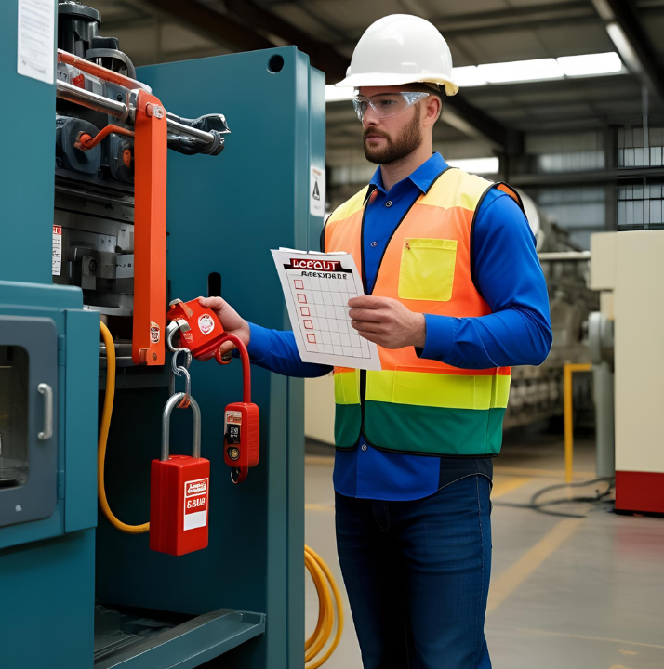
4. Who is an “Authorized Employee” in LOTO?
An authorized employee is a trained worker who performs LOTO procedures on equipment. They are responsible for applying locks/tags, verifying isolation, and ensuring safety before maintenance begins.

Slide 7
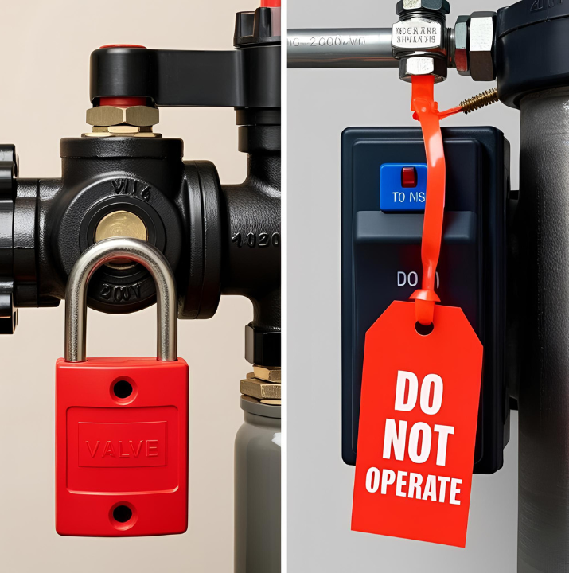
5. What is the difference between Lockout and Tagout?
Lockout uses a physical lock to block energy sources, preventing operation.
Tagout uses a warning tag but does not physically prevent operation. Tags must only be removed by the authorized employee who placed them.

Slide 8
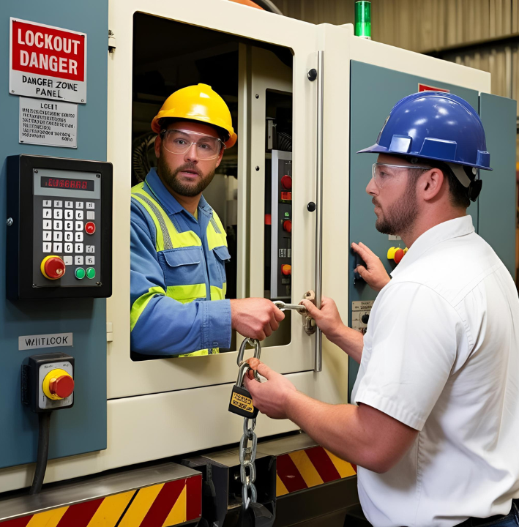
6. When is LOTO required?
LOTO is required when:
Servicing or maintaining equipment where unexpected energization could occur.
Employees must bypass machine guards or enter hazardous zones.
Performing repairs that require exposure to hazardous energy.

Slide 9
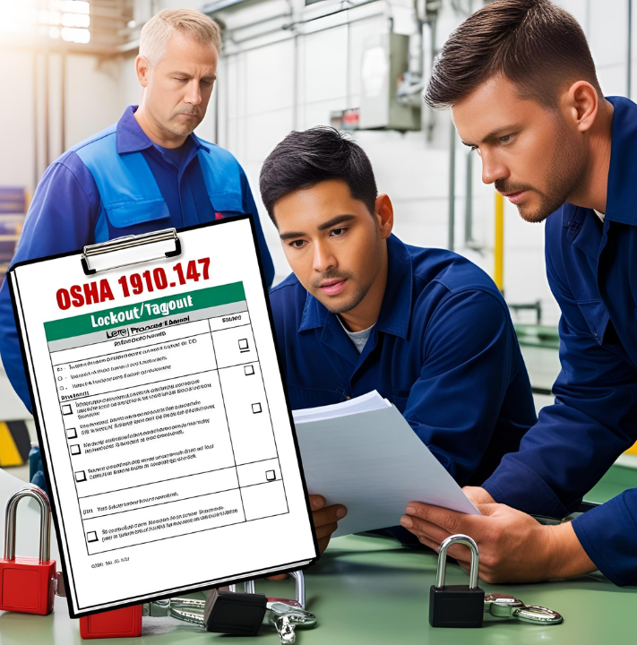
7. What are the OSHA requirements for LOTO?
OSHA’s 1910.147 standard requires:
Written LOTO procedures for each machine.
Employee training (authorized, affected, and other workers).
Periodic inspections of LOTO procedures.
Proper lock and tag devices meeting durability standards.

Slide 10

8. What should you do if you find a lock or tag on equipment?
Never remove someone else’s lock or tag.
Check with the authorized employee who applied it.
Only the person who placed the lock/tag (or a supervisor following proper procedures) can remove it.

Slide 11
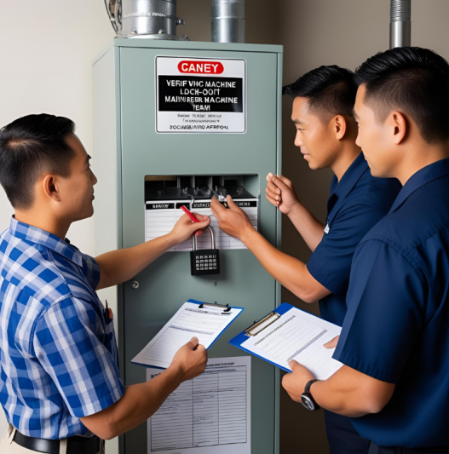
9. How do you handle a situation where a lock must be removed by someone else?
If the original employee is unavailable, follow the employer’s LOTO policy, which may involve:
Verifying the employee’s absence.
Ensuring the equipment is safe to restart.
Removing the lock under supervision and documenting the action.

Slide 12
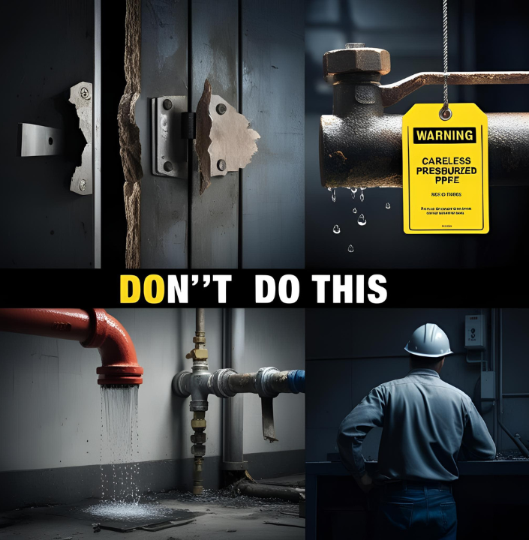
10. What are common mistakes in LOTO procedures?
Common mistakes include:
Failing to isolate all energy sources.
Not verifying zero energy before work begins.
Using damaged or non-compliant locks/tags.
Removing locks without authorization.

