Slide 1
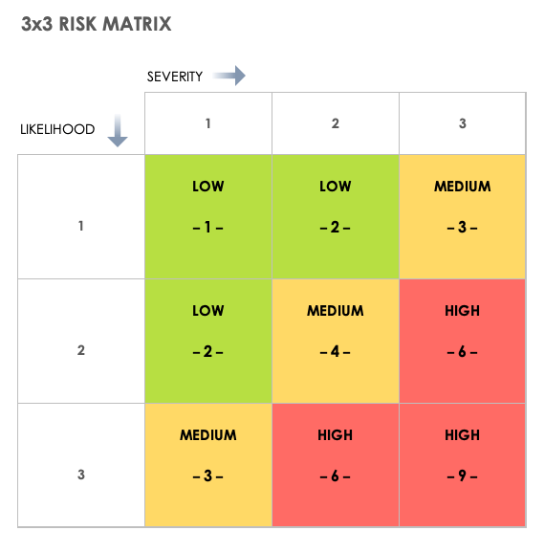
3x3
Risk Assessment Matrix

Slide 2
Safety Engineer Visa Sponsorship Available Jobs
Safety Officer NEBOSH Salary
3×3 Risk Assessment Matrix
5×5 Risk Assessment Matrix
Check Description
www.hsestudyguide.com

Slide 3
3x3 Risk Assessment Matrix
The 3x3 Risk Assessment Matrix evaluates risks using two factors:
Likelihood (Probability of occurrence)
Severity (Potential impact of the risk)
Each factor is rated on a scale from 1 to 3,
resulting in a grid with 9 possible risk levels.
The matrix is color-coded to help
decision-makers prioritize risk mitigation.

Slide 4
Key Components of the 3x3 Risk Matrix
This matrix consists of 3 levels of Likelihood and 3 levels of Severity, forming a 3x3 grid (total 9 possible risk scores).
1. Likelihood (Probability) Levels
Level | Description
1 | Unlikely (Rarely happens)
2 | Possible (Could happen sometimes)
3 | Likely (Happens frequently)

Slide 5
Key Components of the 3x3 Risk Matrix
This matrix consists of 3 levels of Likelihood and 3 levels of Severity, forming a 3x3 grid (total 9 possible risk scores).
2. Severity (Impact) Levels
Level | Description
1 | Minor (Little or no injury/damage)
2 | Moderate (Injury requiring medical attention, moderate damage)
3 | Major (Serious injury or fatality, major damage)

Slide 6
Risk Rating & Color Coding
The final risk score is determined by multiplying Likelihood × Severity. This score is then categorized into color-coded risk levels:
1-2 (Low Risk - Green) – Minimal controls needed
3-4 (Medium Risk - Yellow) – Requires monitoring and action
6-9 (High Risk - Red) – Immediate corrective measures required

Slide 7
How to Use the 3x3 Risk Matrix?
Identify Hazards – Determine potential risks.
Assess Likelihood – Rate how often the risk might occur.
Evaluate Severity – Determine the impact of the risk.
Calculate the Risk Score – Multiply Likelihood × Severity.
Implement Controls – Apply necessary measures to reduce risks.
Review & Update – Continuously monitor and adjust the assessment.

Slide 8
Example of Risk Assessment Using 3x3 Matrix
Scenario: Slippery Floor in a Workplace
Identify Hazard: A wet floor in a common walkway.
Assess Likelihood: If cleaning staff do not place warning signs, someone is likely to slip (Likely - Level 3).
Assess Severity: A fall could cause a broken bone or serious injury (Major - Level 3).
Calculate Risk Score: Likelihood (3) × Severity (3) = 9(High Risk)
Control Measures:
  Place "Wet Floor" warning signs.
  Improve floor drainage.
  Ensure spills are cleaned immediately.

